Slide 1
Canadian Lighthouses
Lake Ontario
Kris E Roberts

Slide 2
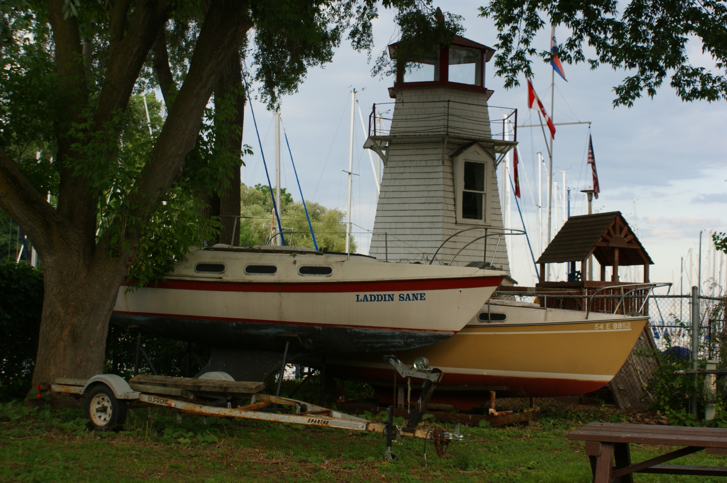
Can-Ont-2

Slide 3
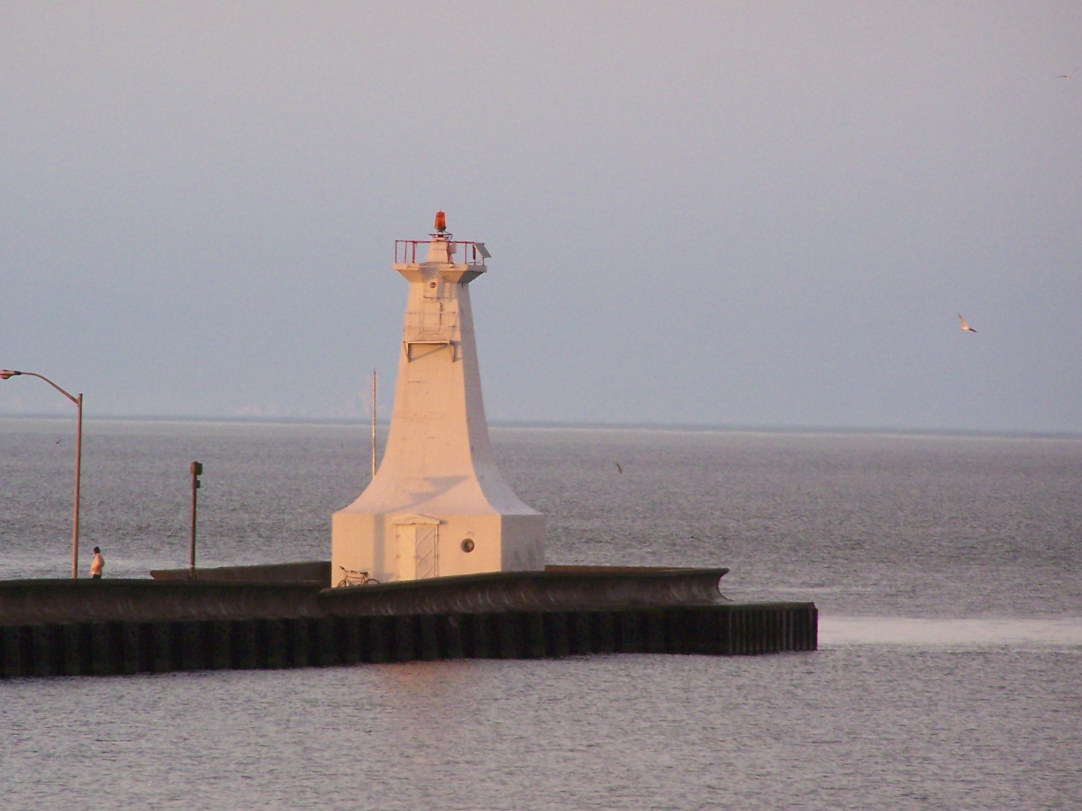
Can-Ont-Burlington Canal Front Range

Slide 4
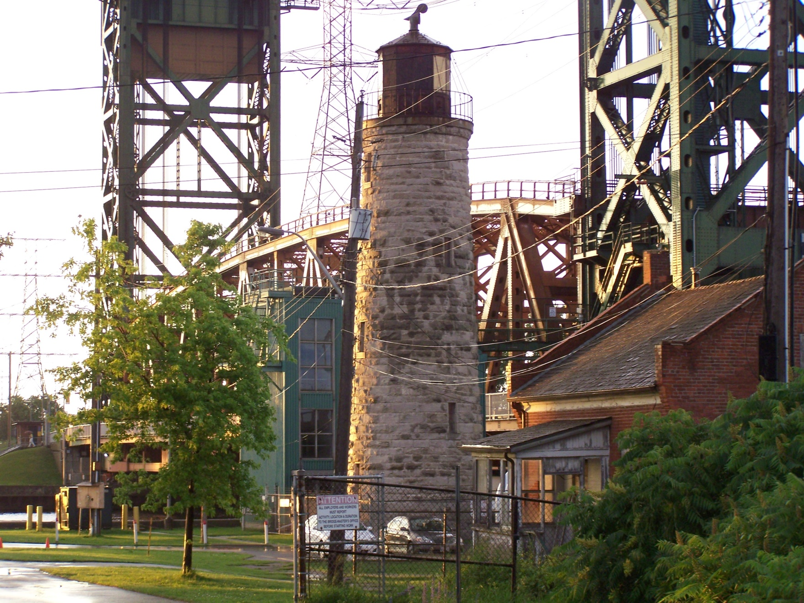
Can-Ont-Burlington Main

Slide 5
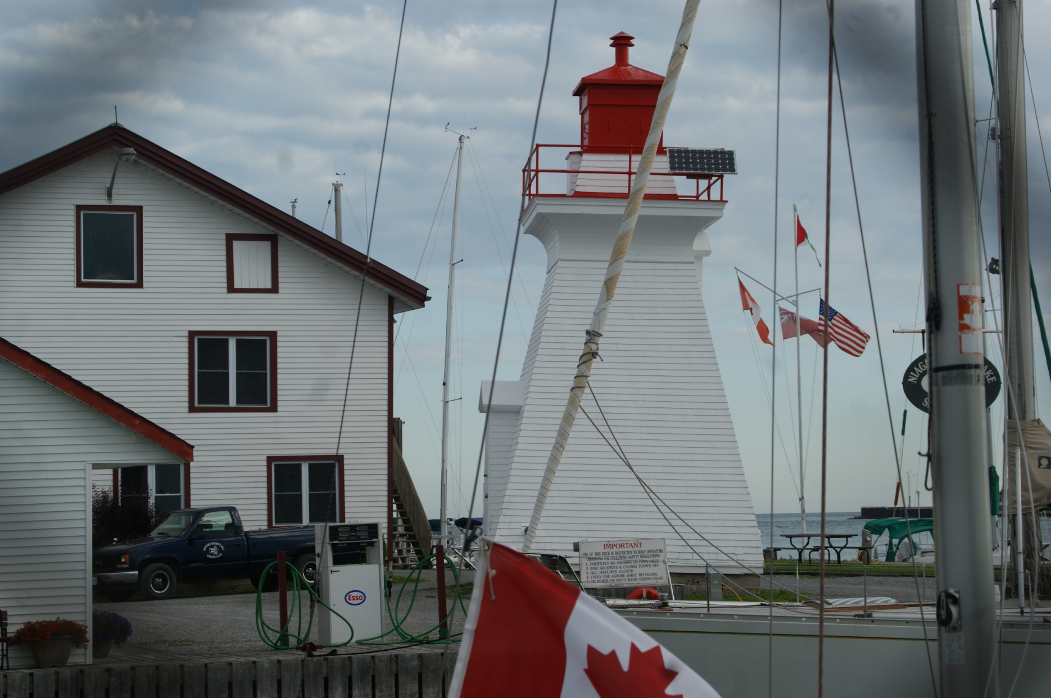
Can-Ont-Niagara River Front Range (2)

Slide 6
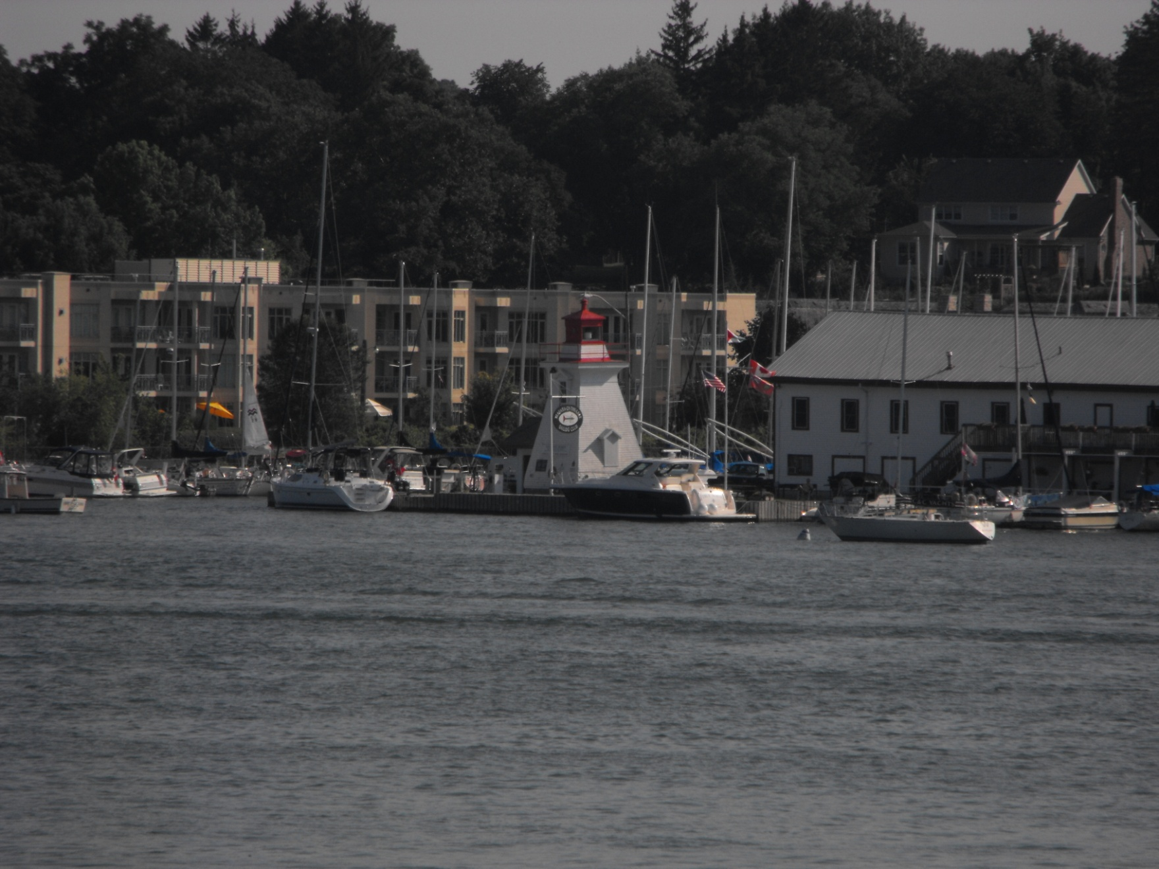
Can-Ont-Niagara River Front Range

Slide 7
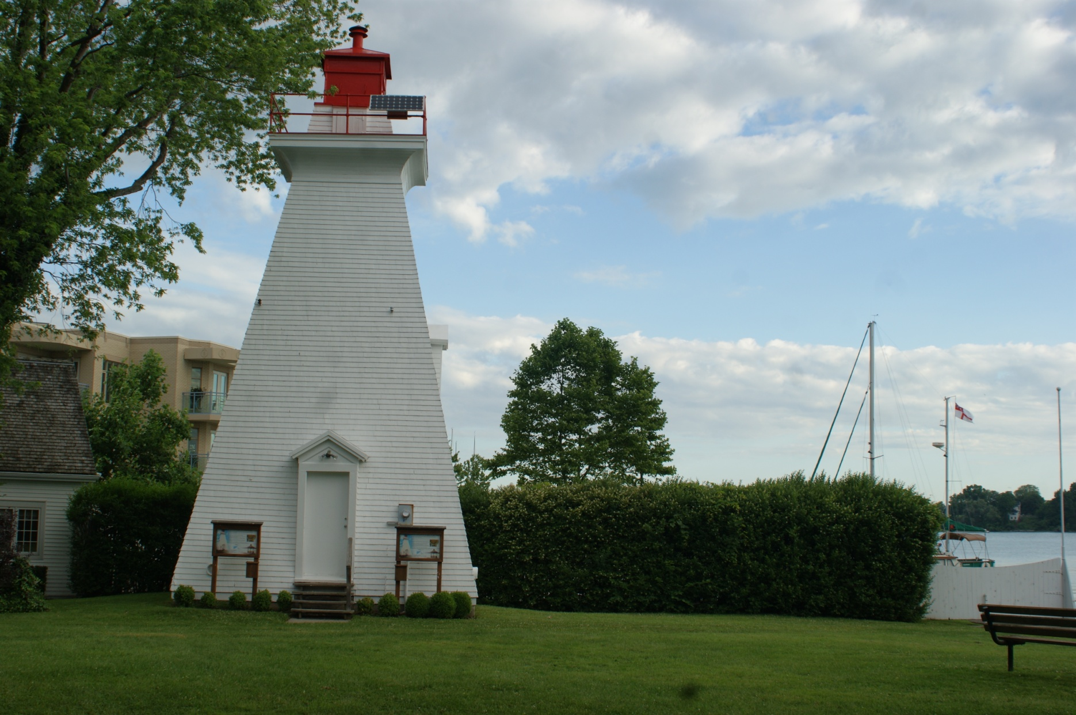
Can-Ont-Niagara River Rear Range

Slide 8
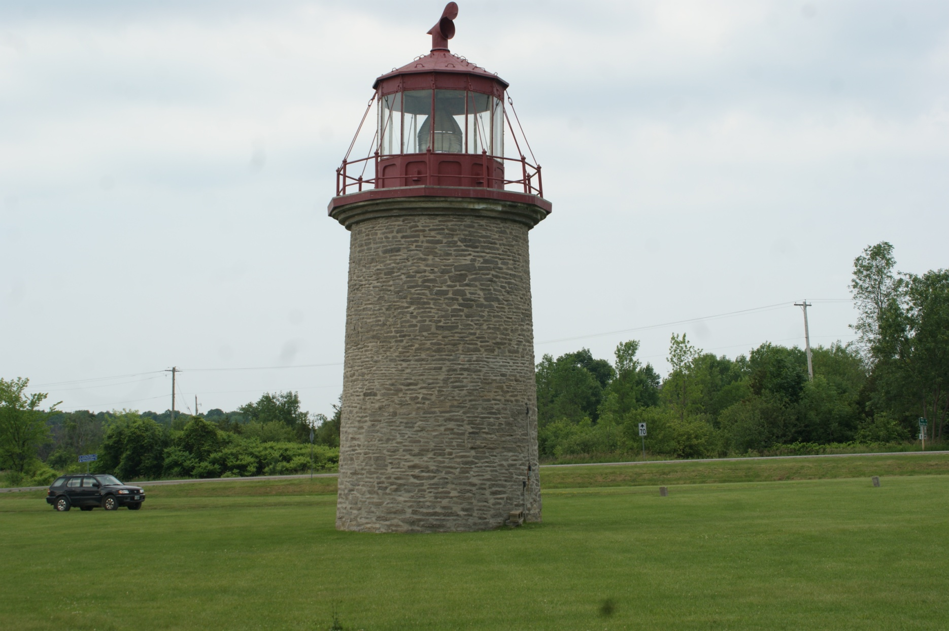
CAn-Ont-Old Fake Duck Island

Slide 9
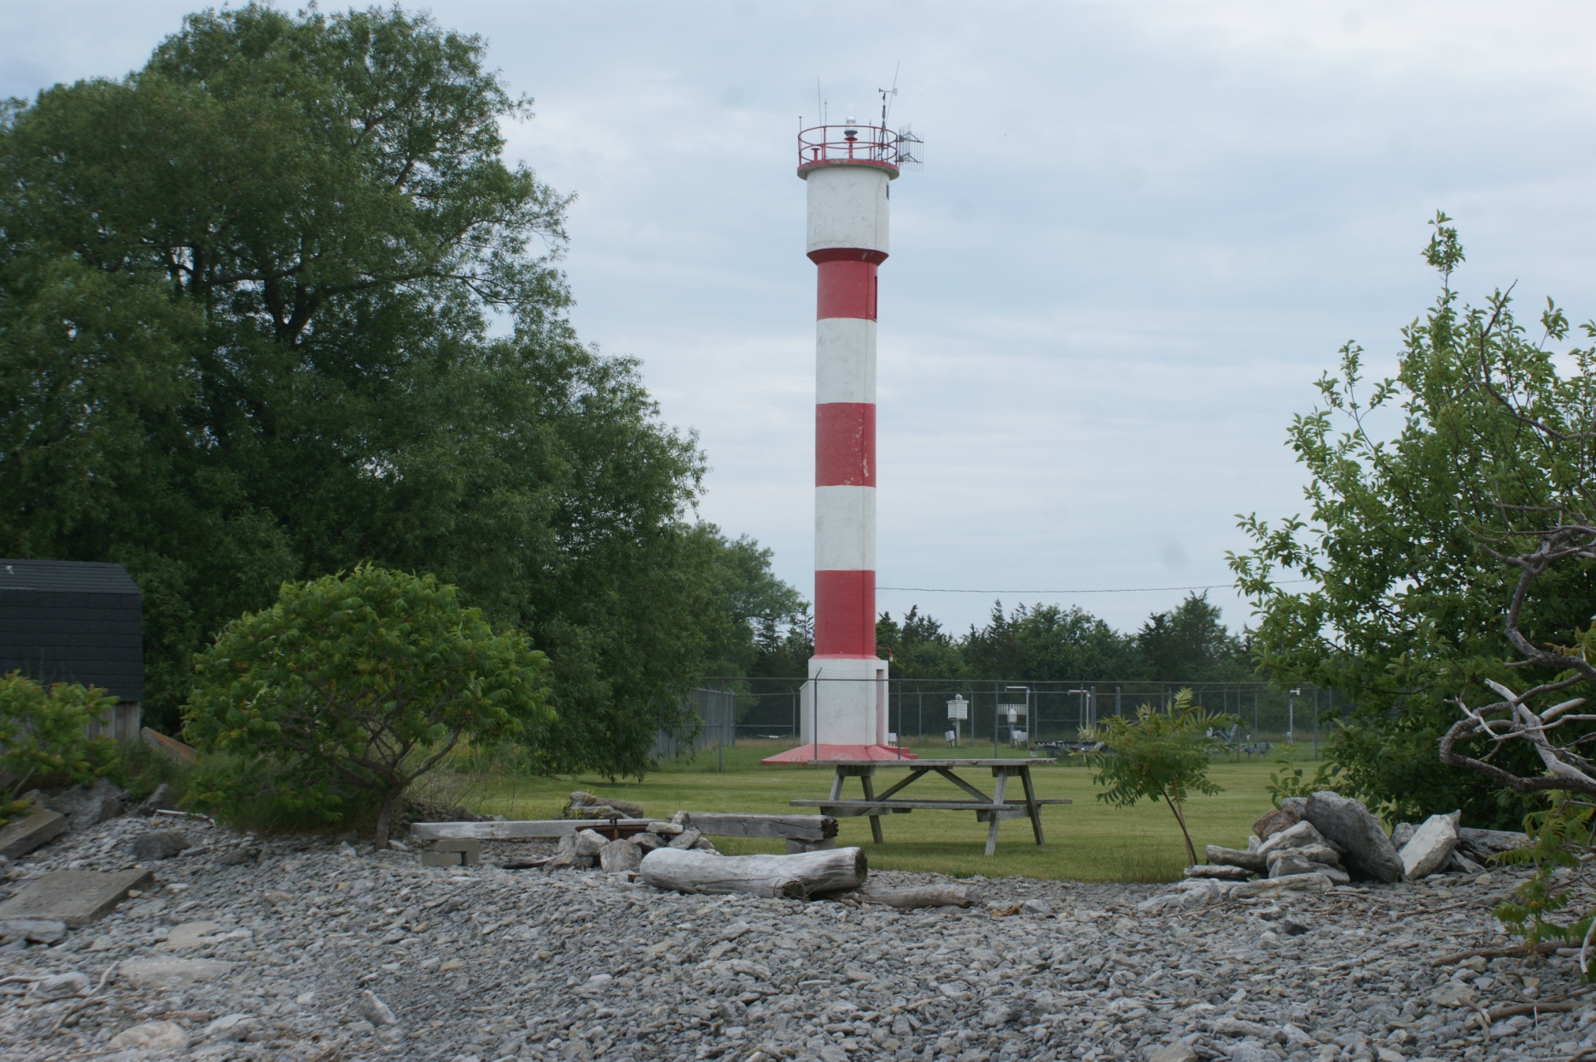
Can-Ont-Pointe Petre

Slide 10
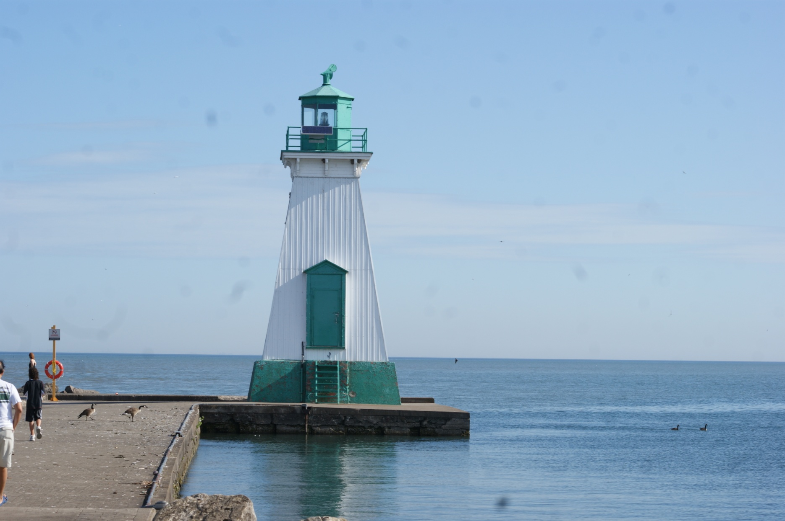
Can-Ont-Port Dalhousie Front Range

Slide 11
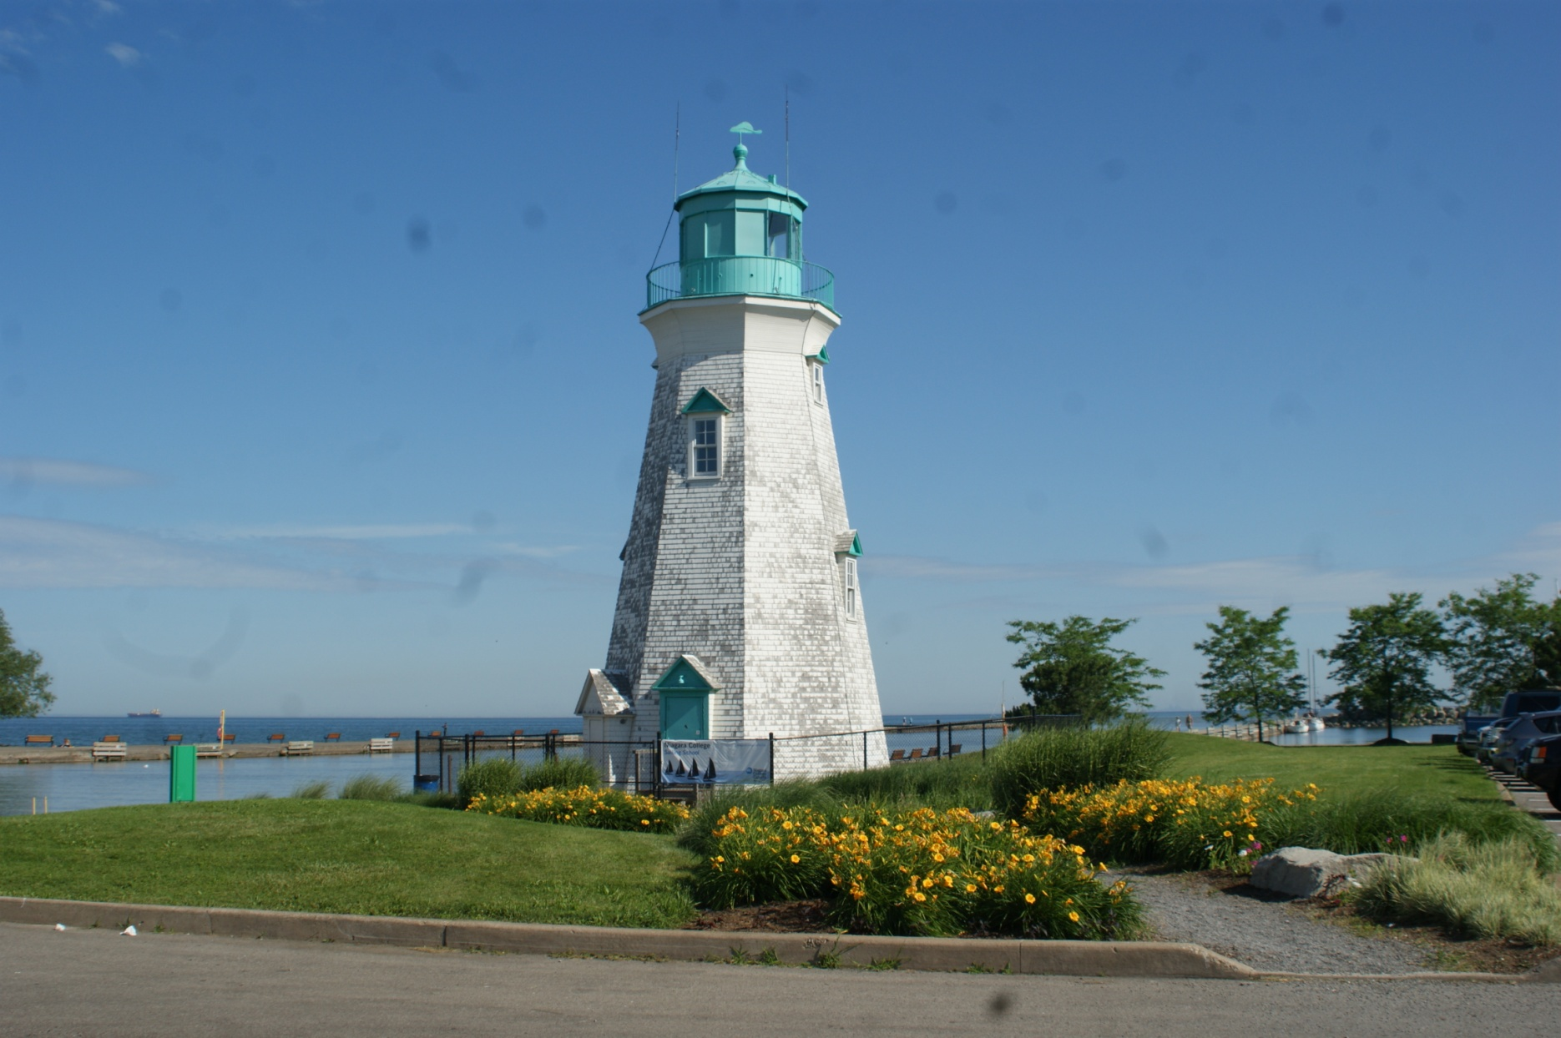
Can-Ont-Port Dalhousie Rear Range

Slide 12
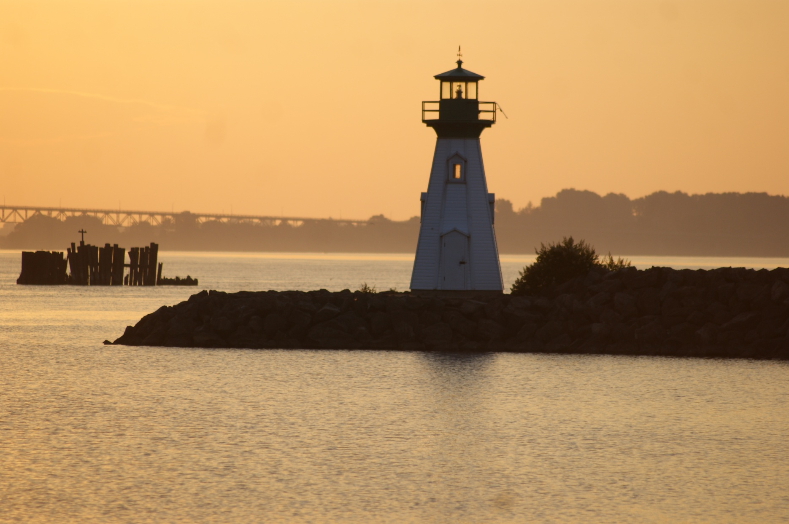
Can-Ont-Prescott Breakwater

Slide 13
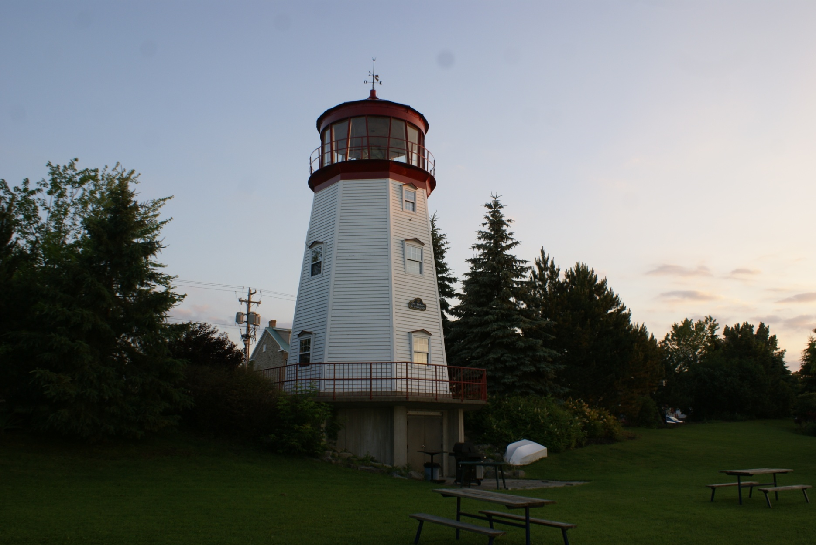
Can-Ont-Prescott Visitor's Center

Slide 14
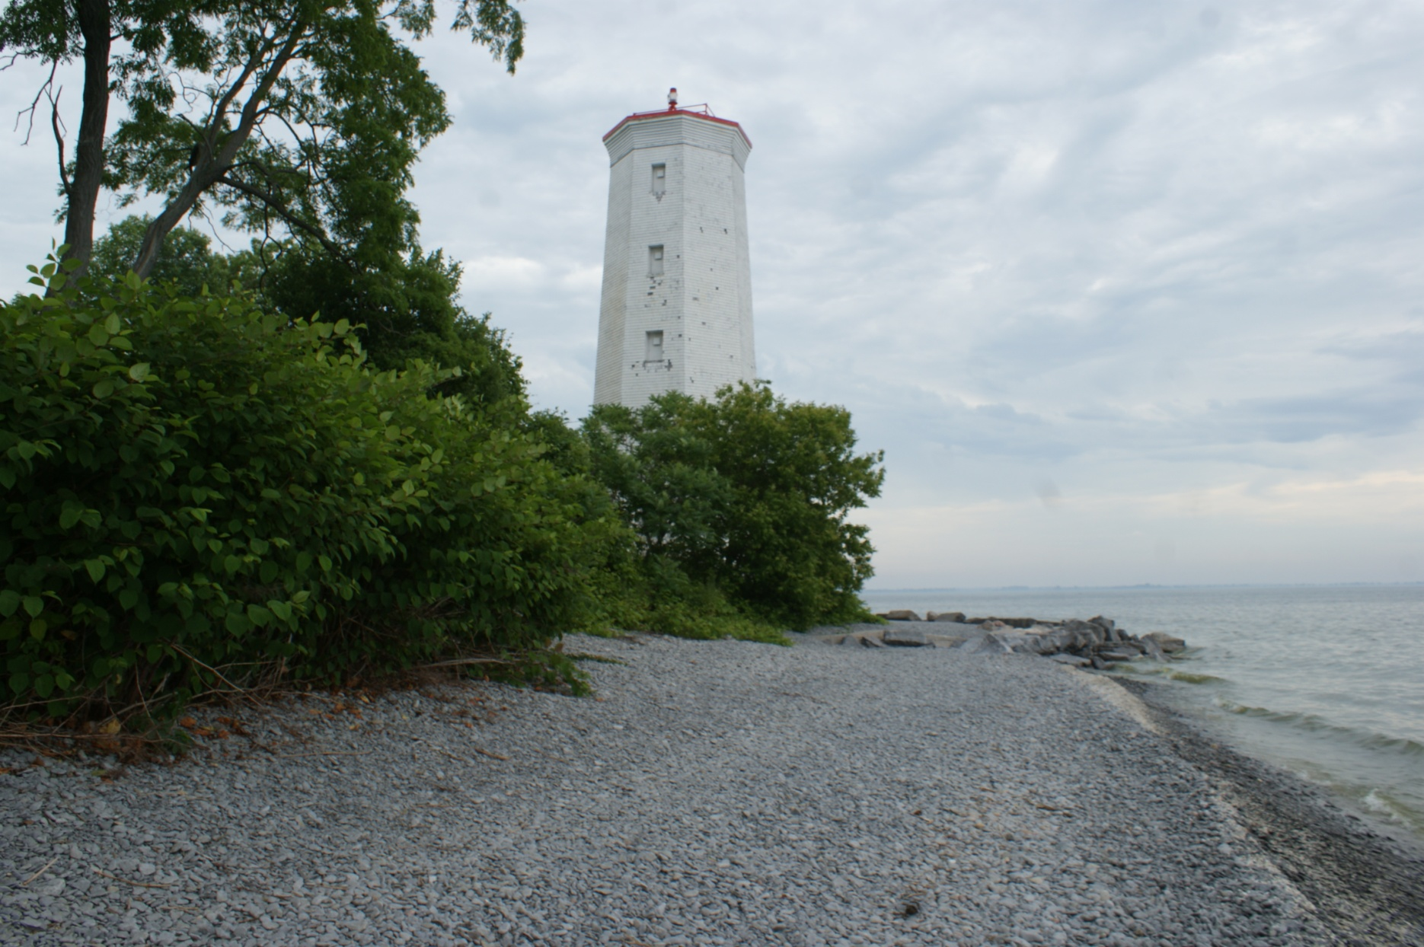
Can-Ont-Presq'ile Point

Slide 15
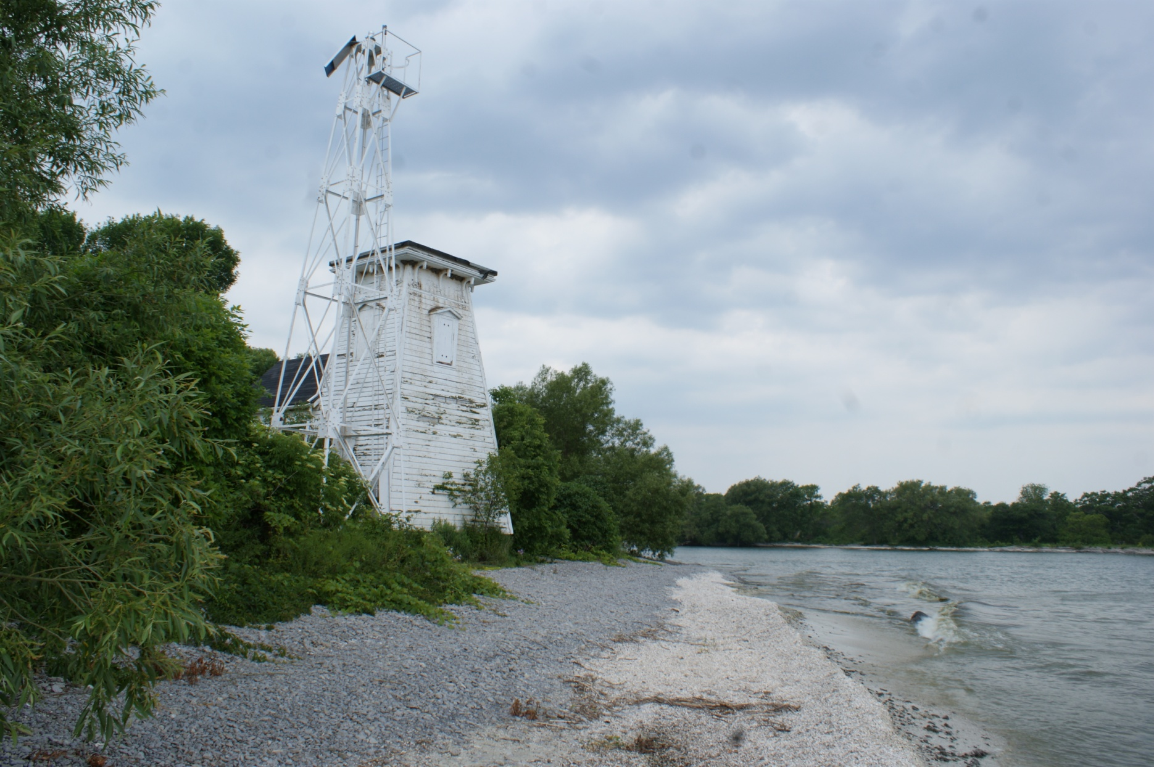
Can-Ont-Prince Edward Point

Slide 16
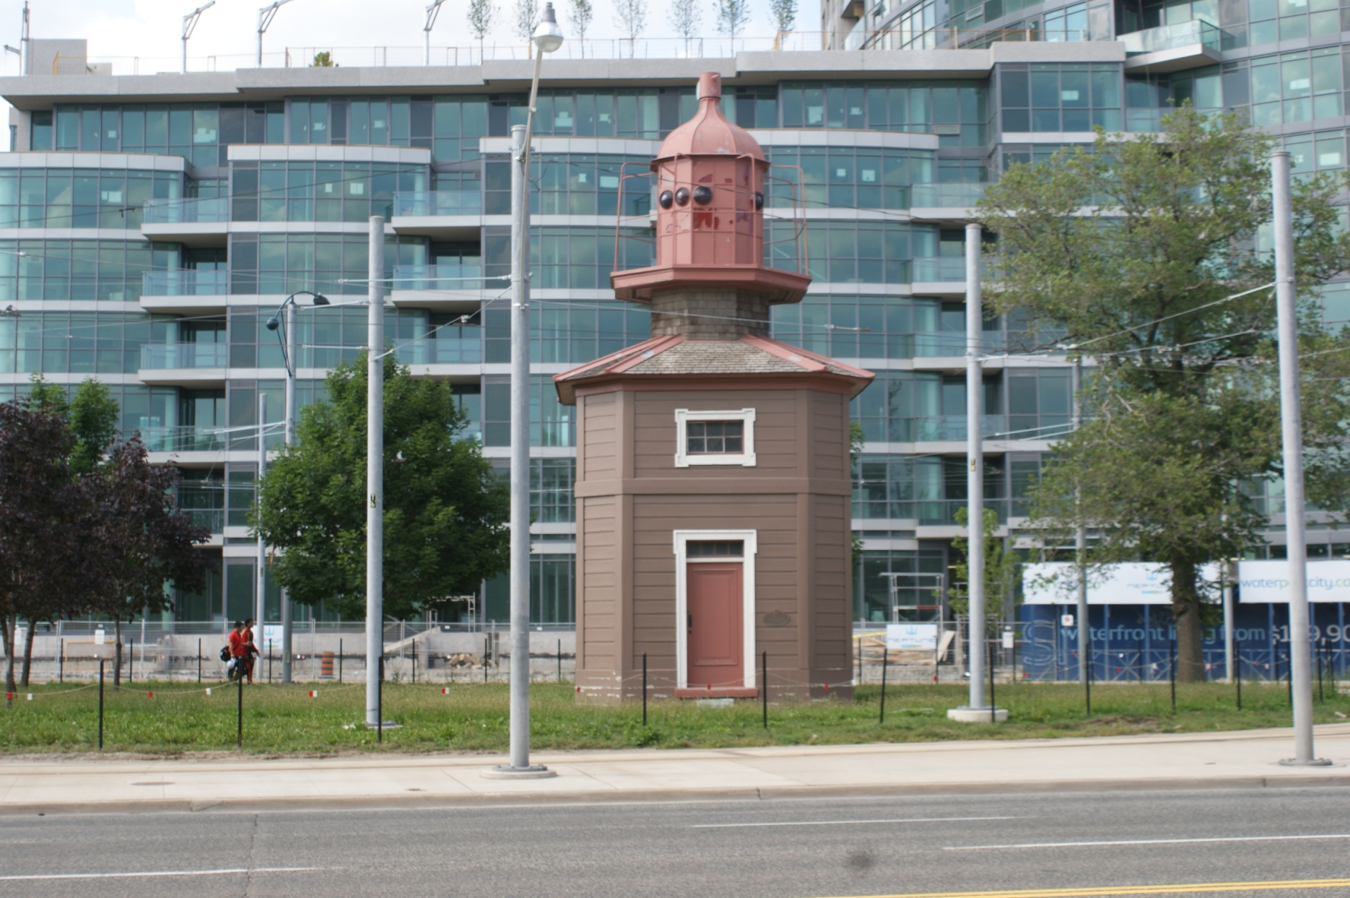
Can-Ont-Queen's Wharf

Slide 17
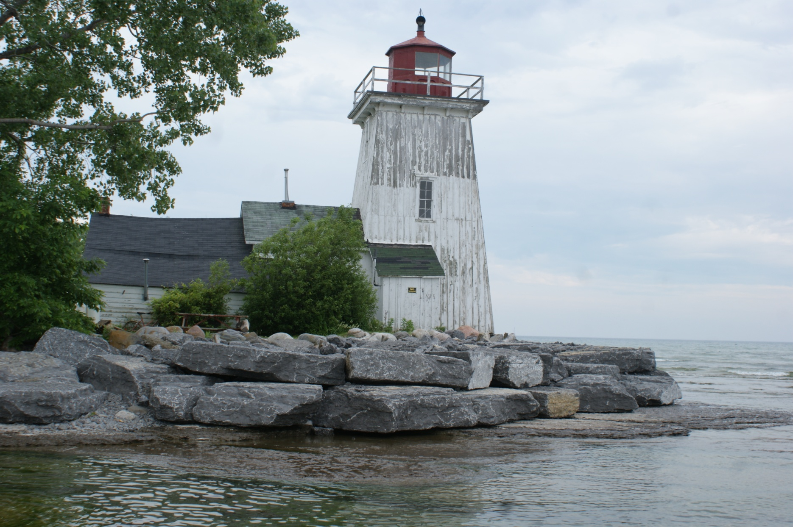
Can-Ont-Salmon Point

Slide 18
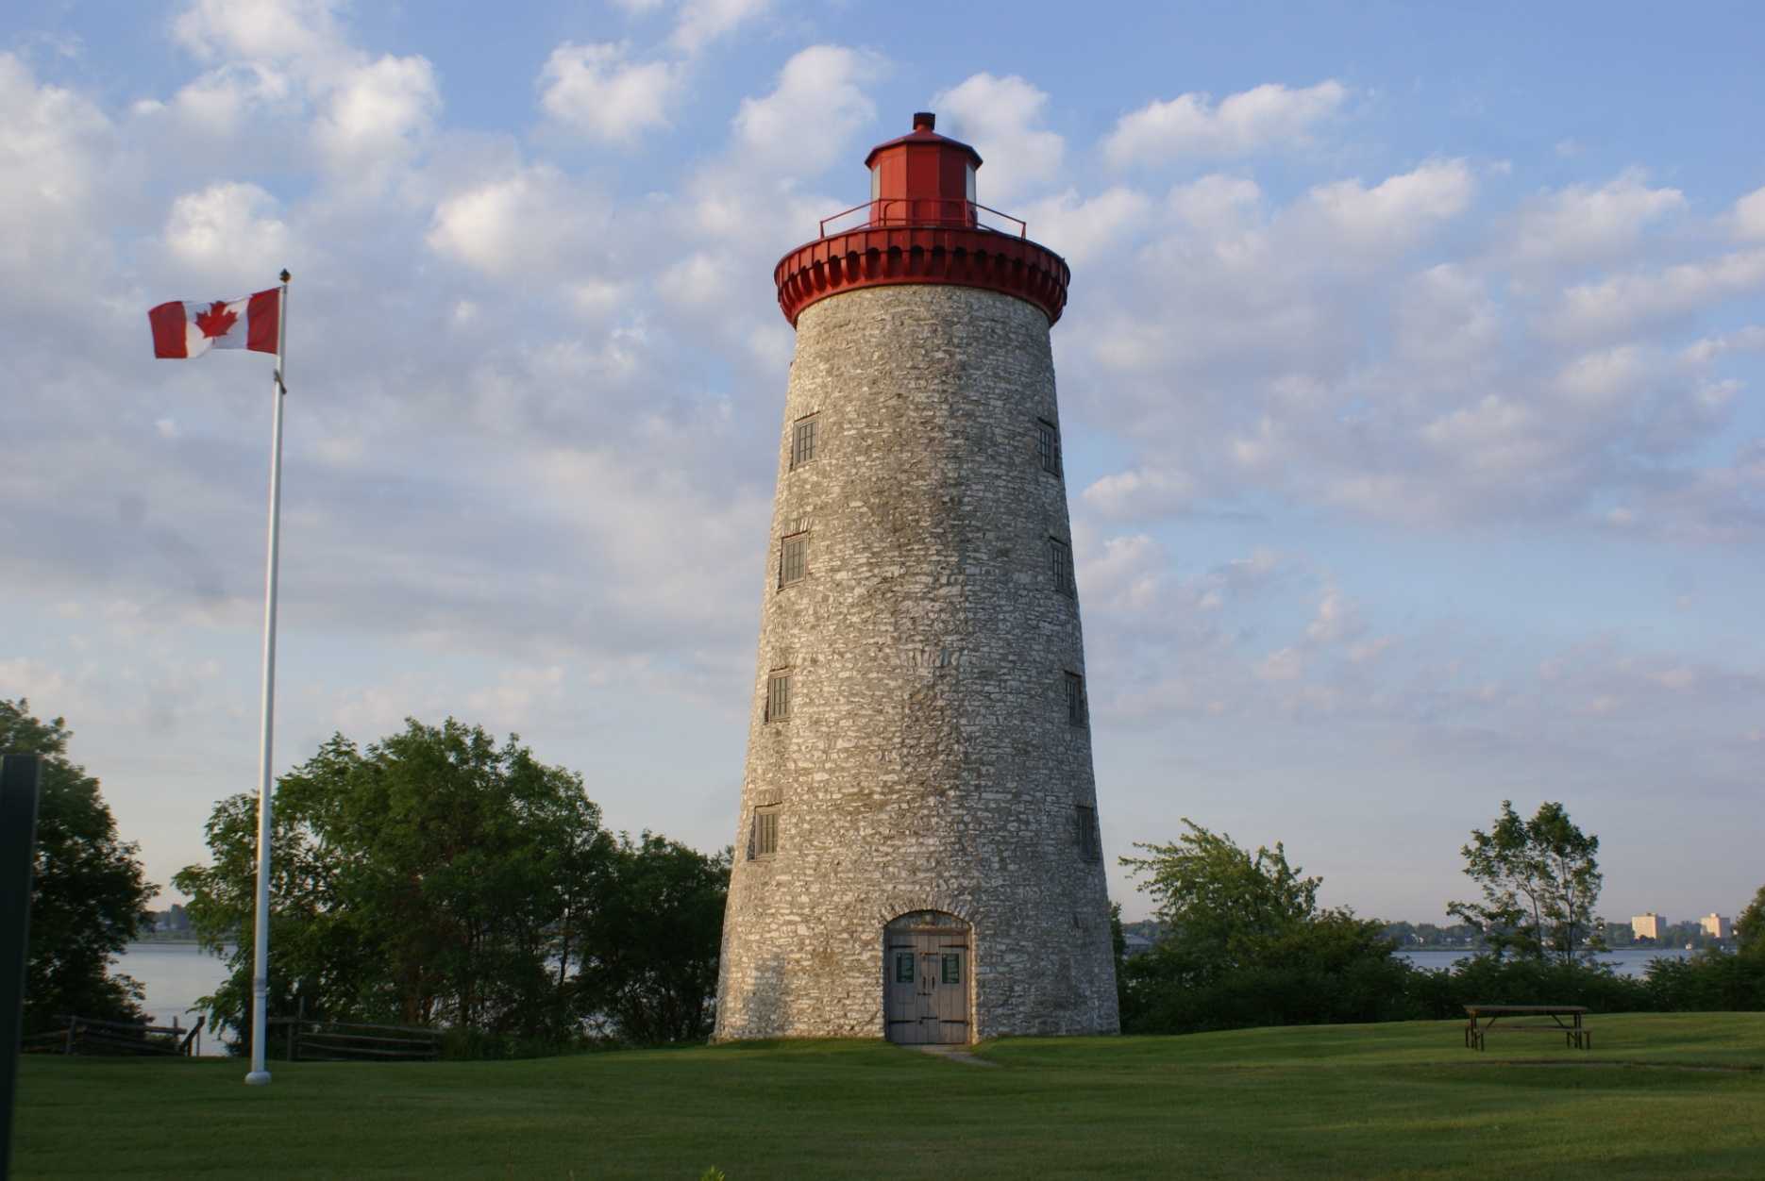
Can-Ont-Windmill Point

