Slide 1
Canadian Lighthouses
Prince Edward Island
Kris E Roberts

Slide 2
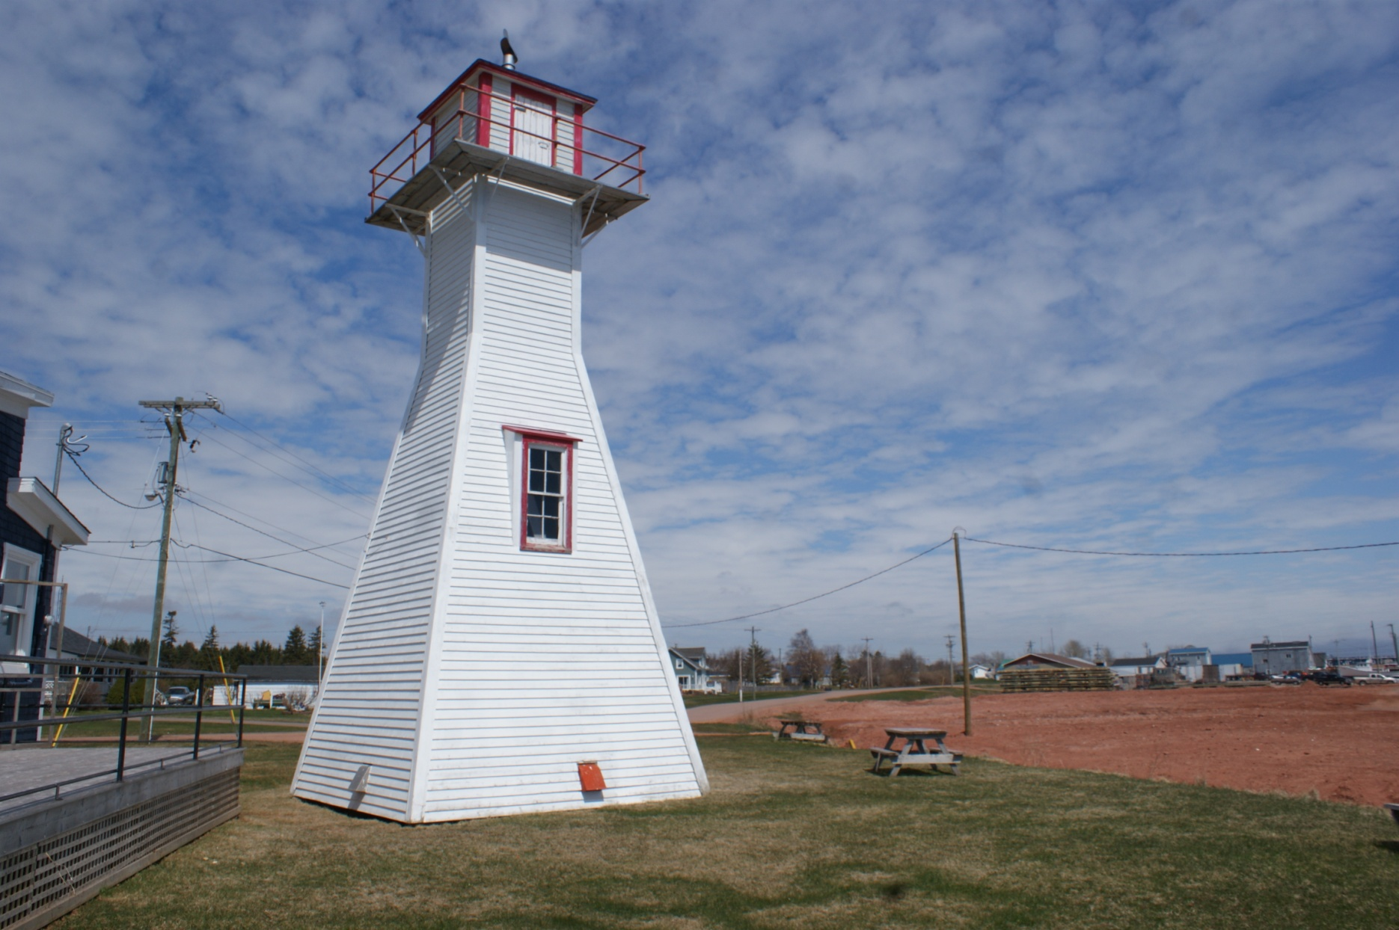
Can-PEI-Northport Range Rear

Slide 3
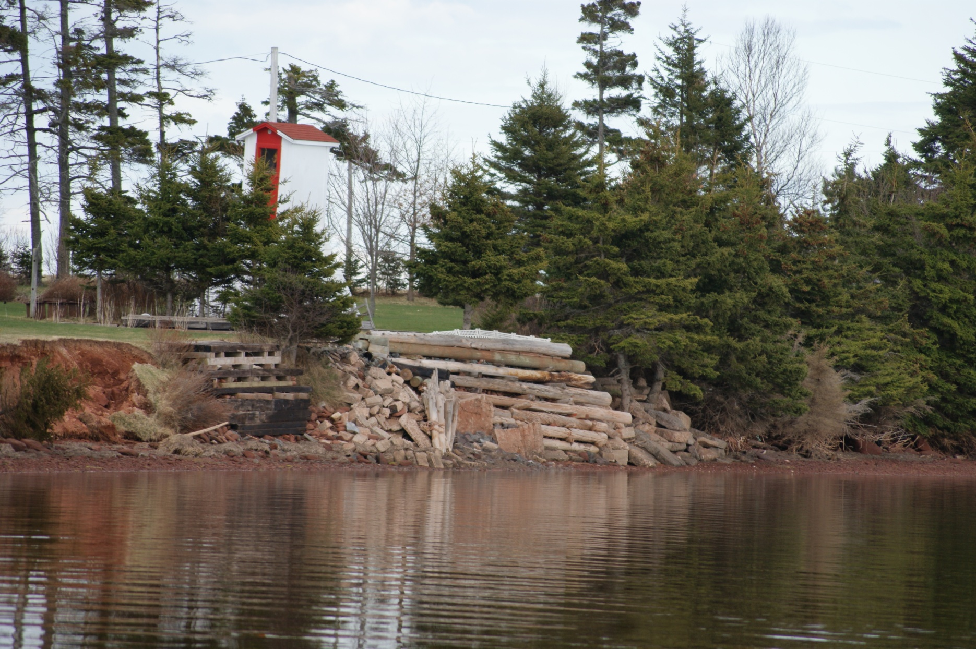
Can-PEI-Annandale Former Range Front

Slide 4
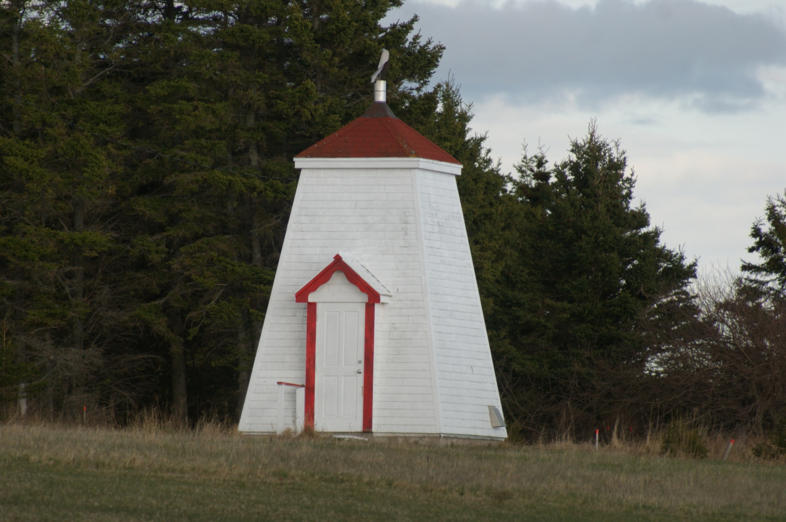
Can-PEI-Annandale Range Front

Slide 5
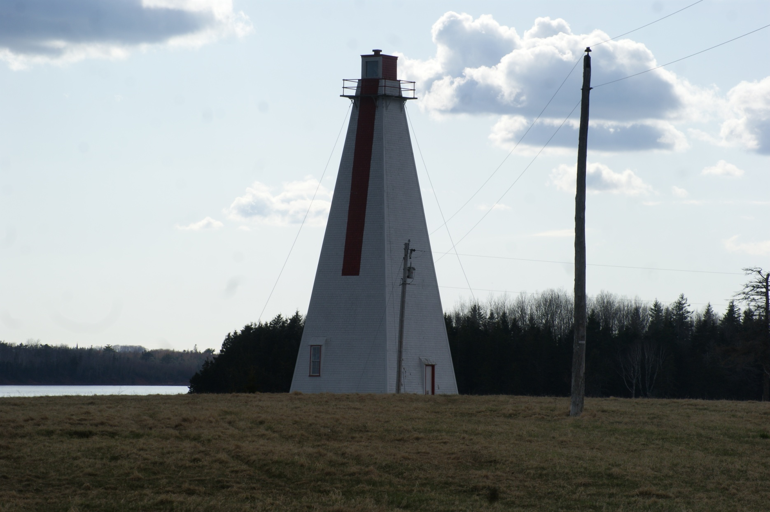
Can-PEI-Annandale Range Rear

Slide 6
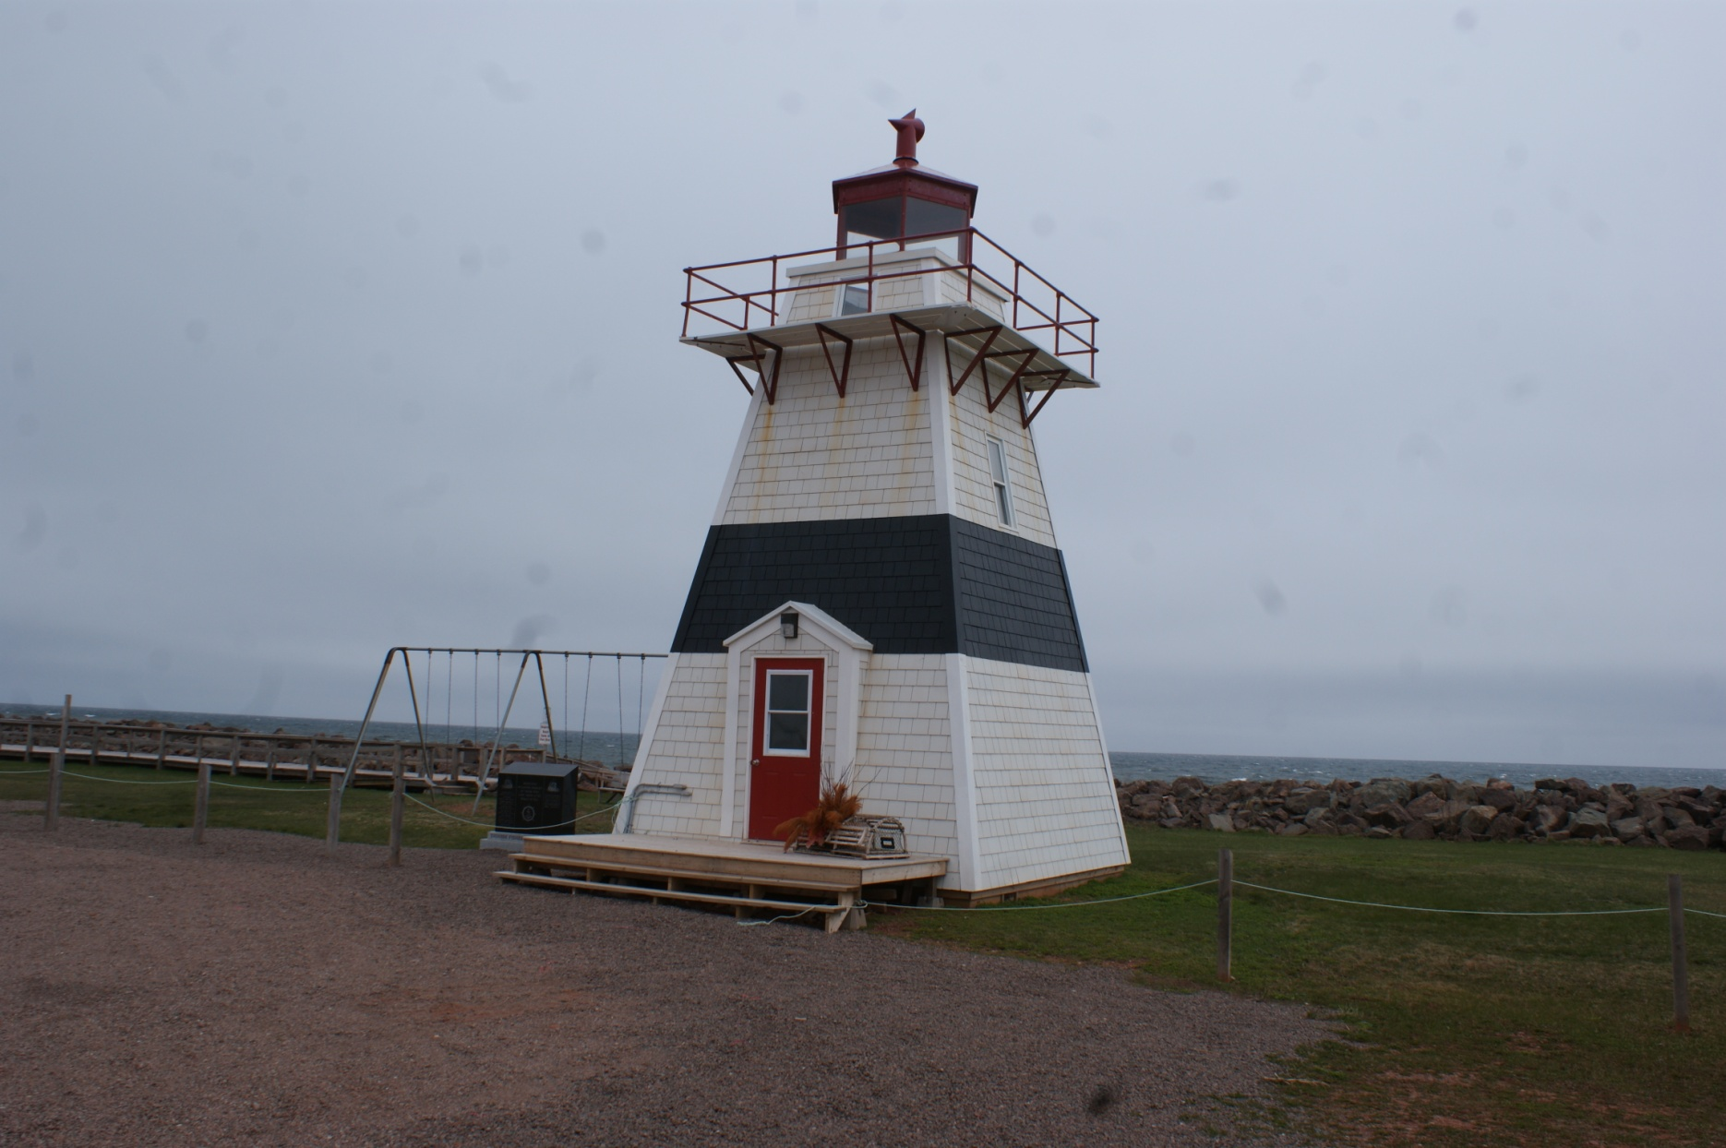
Can-PEI-Big Tignish

Slide 7
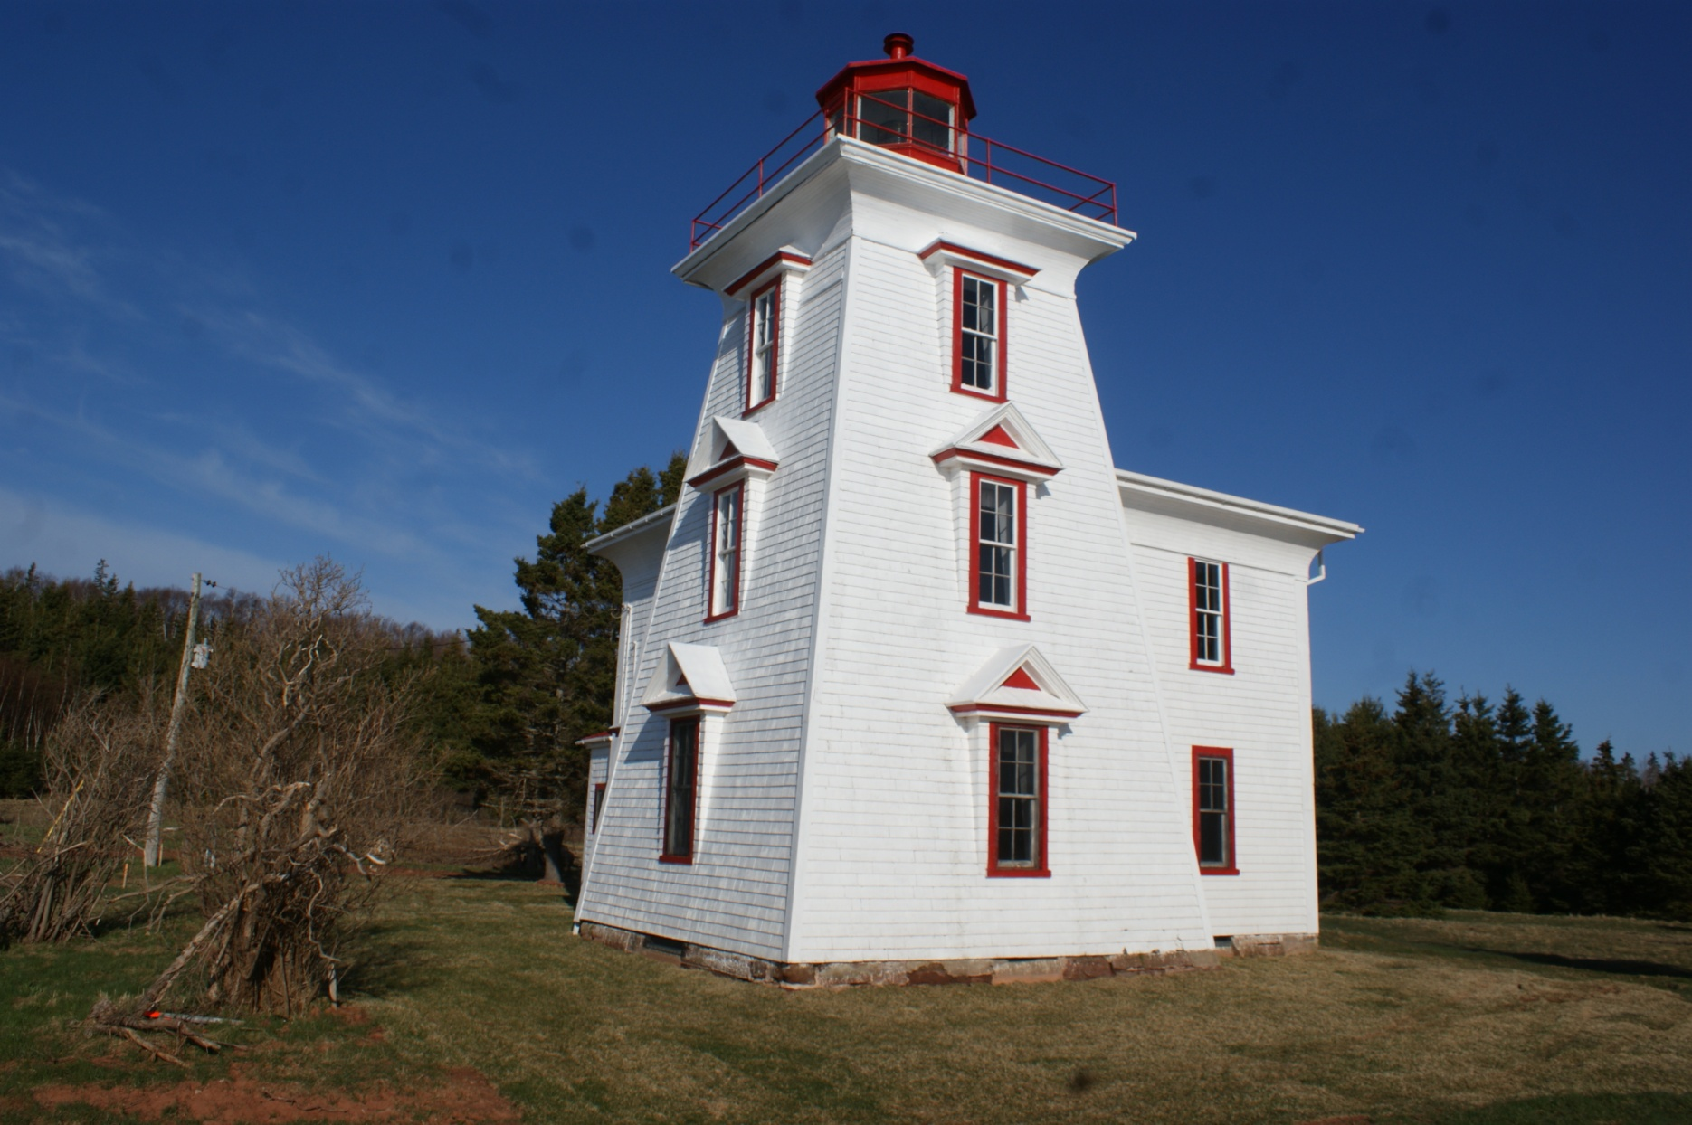
Can-PEI-Blockhouse Point

Slide 8
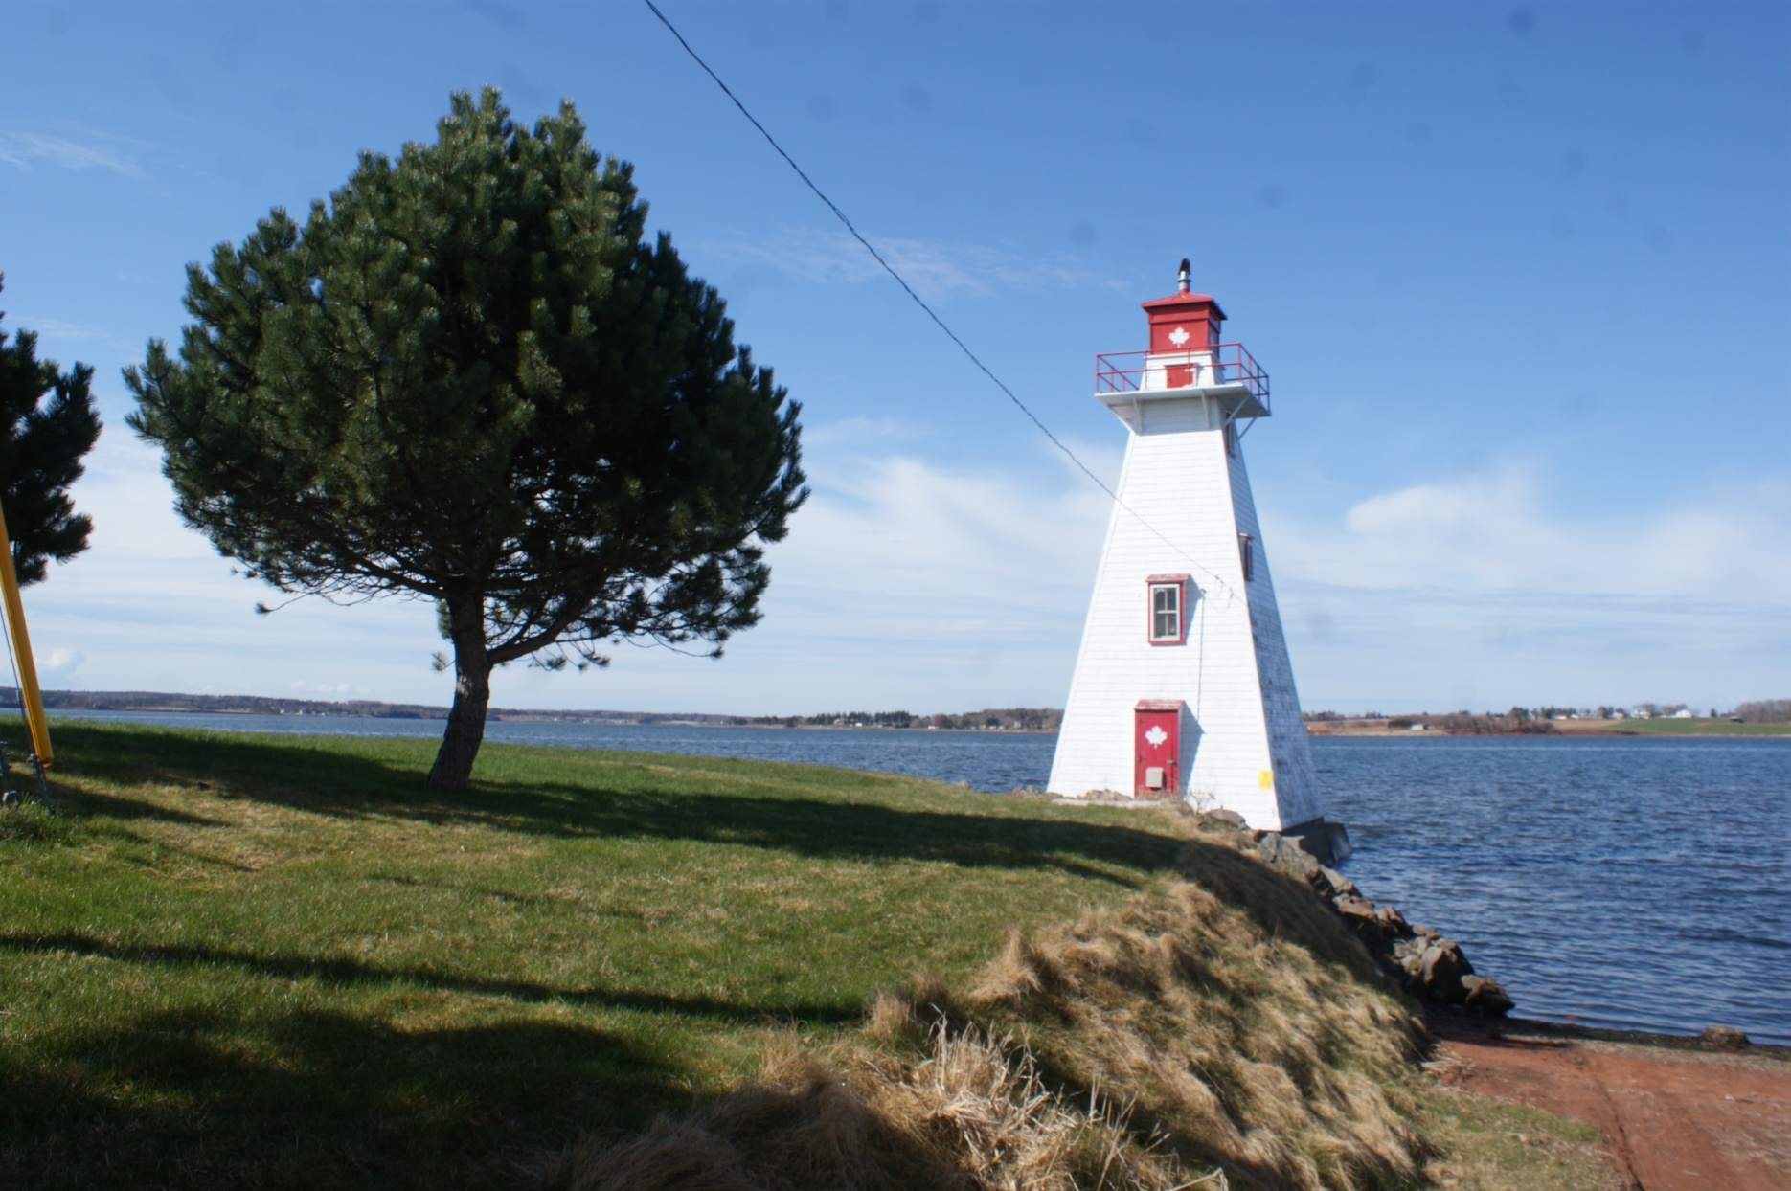
Can-PEI-Brighton Beach Range Front

Slide 9
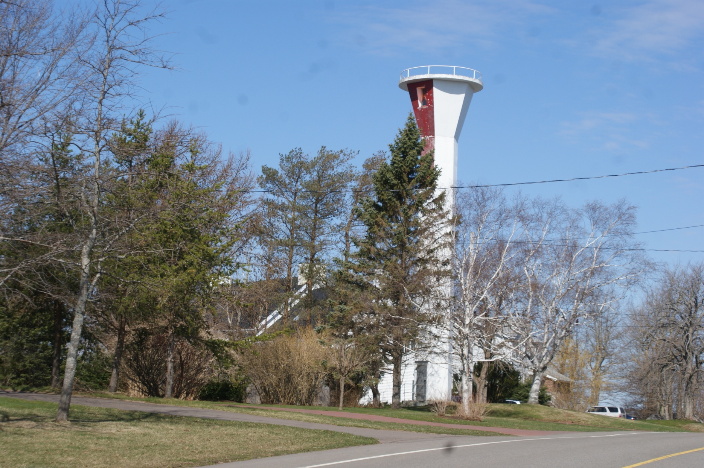
Can-PEI-Brighton Beach Range Rear

Slide 10
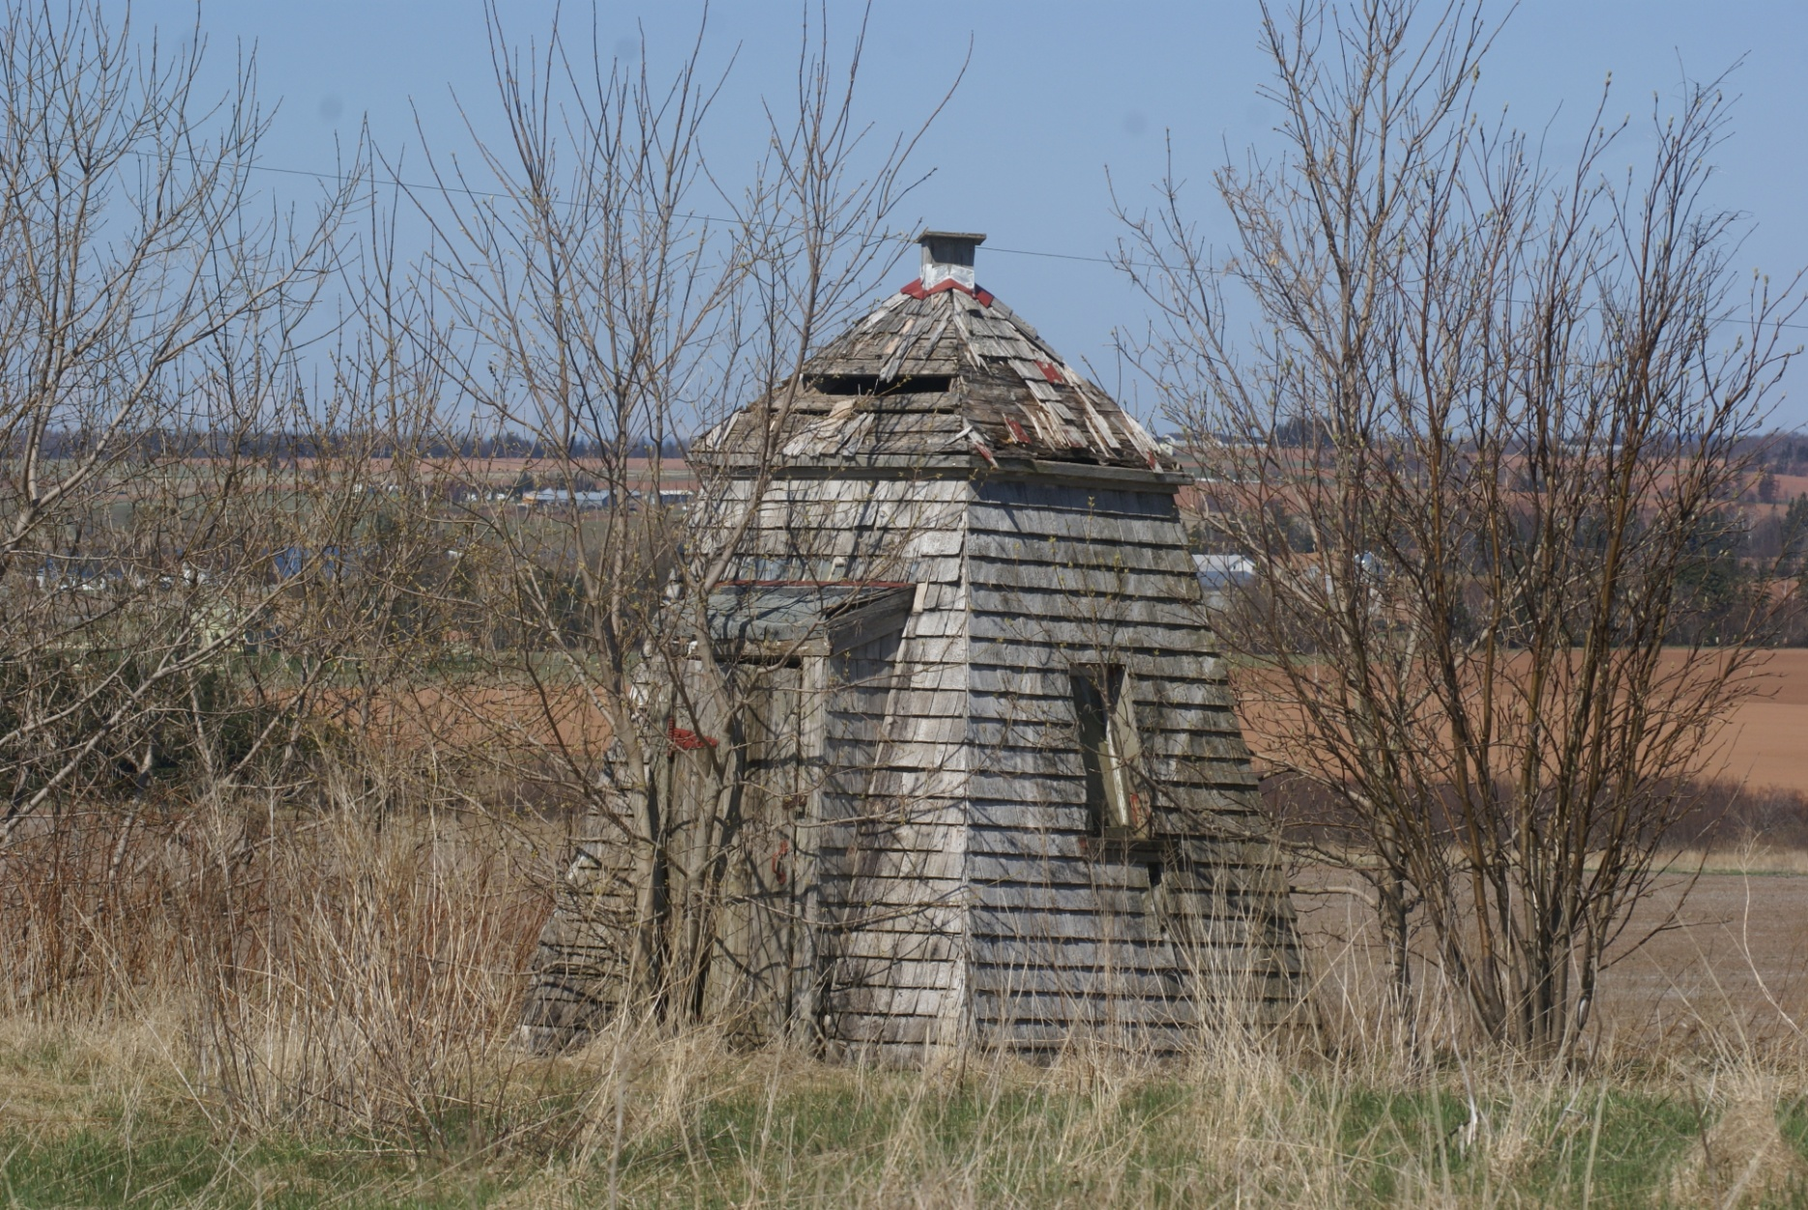
Can-PEI-Brush Wharf Rear

Slide 11
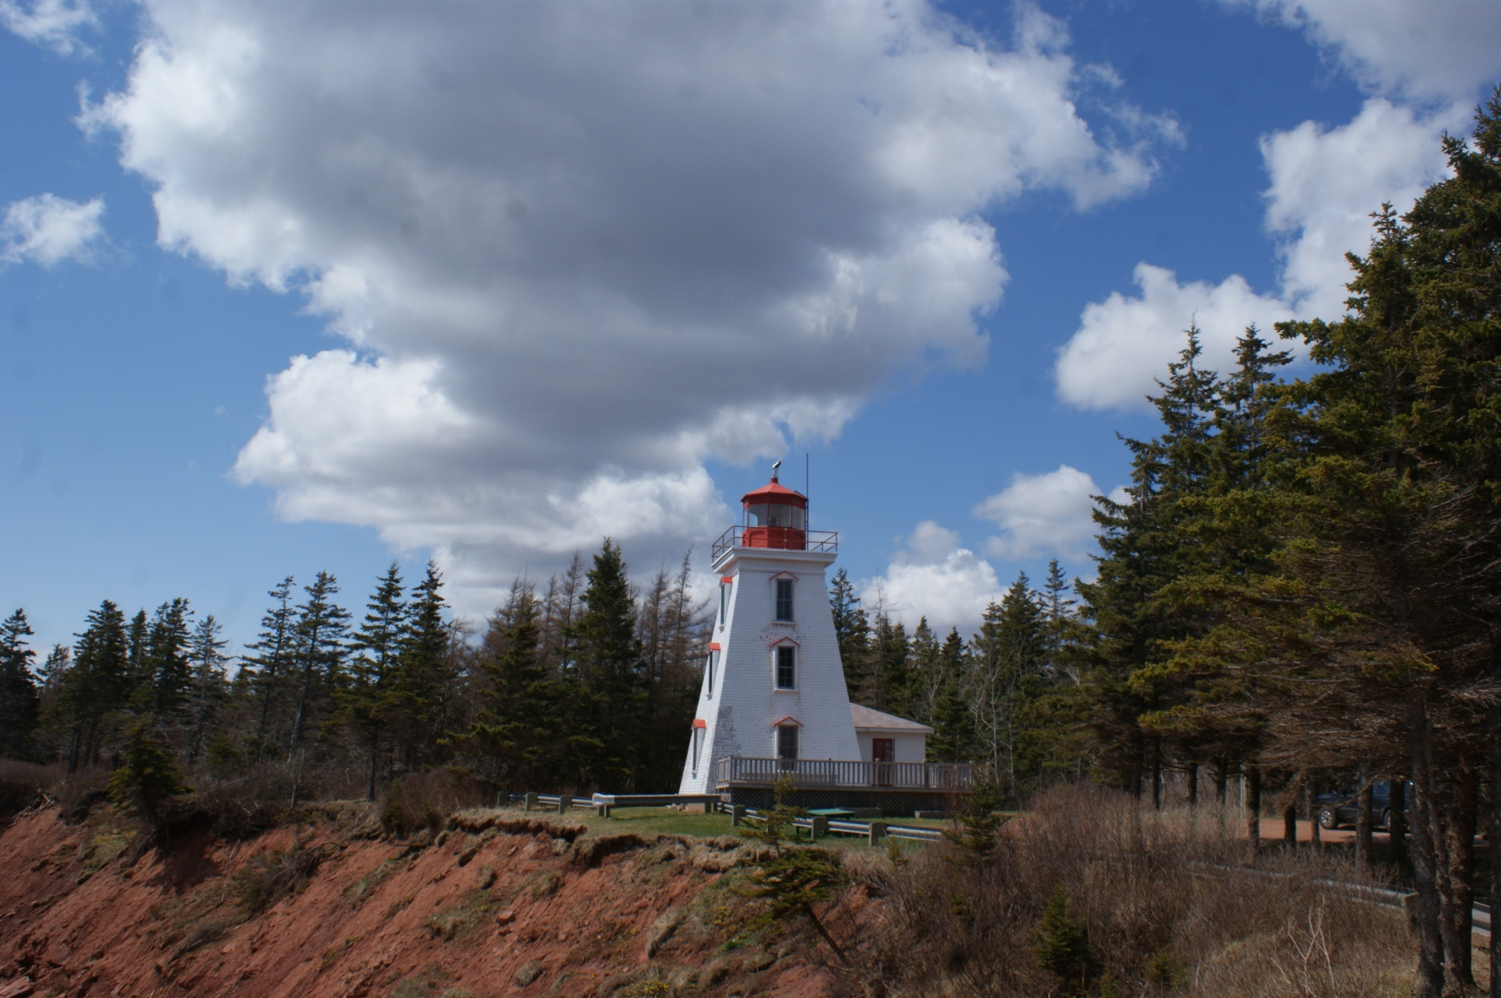
Can-PEI-Cape Bear

Slide 12
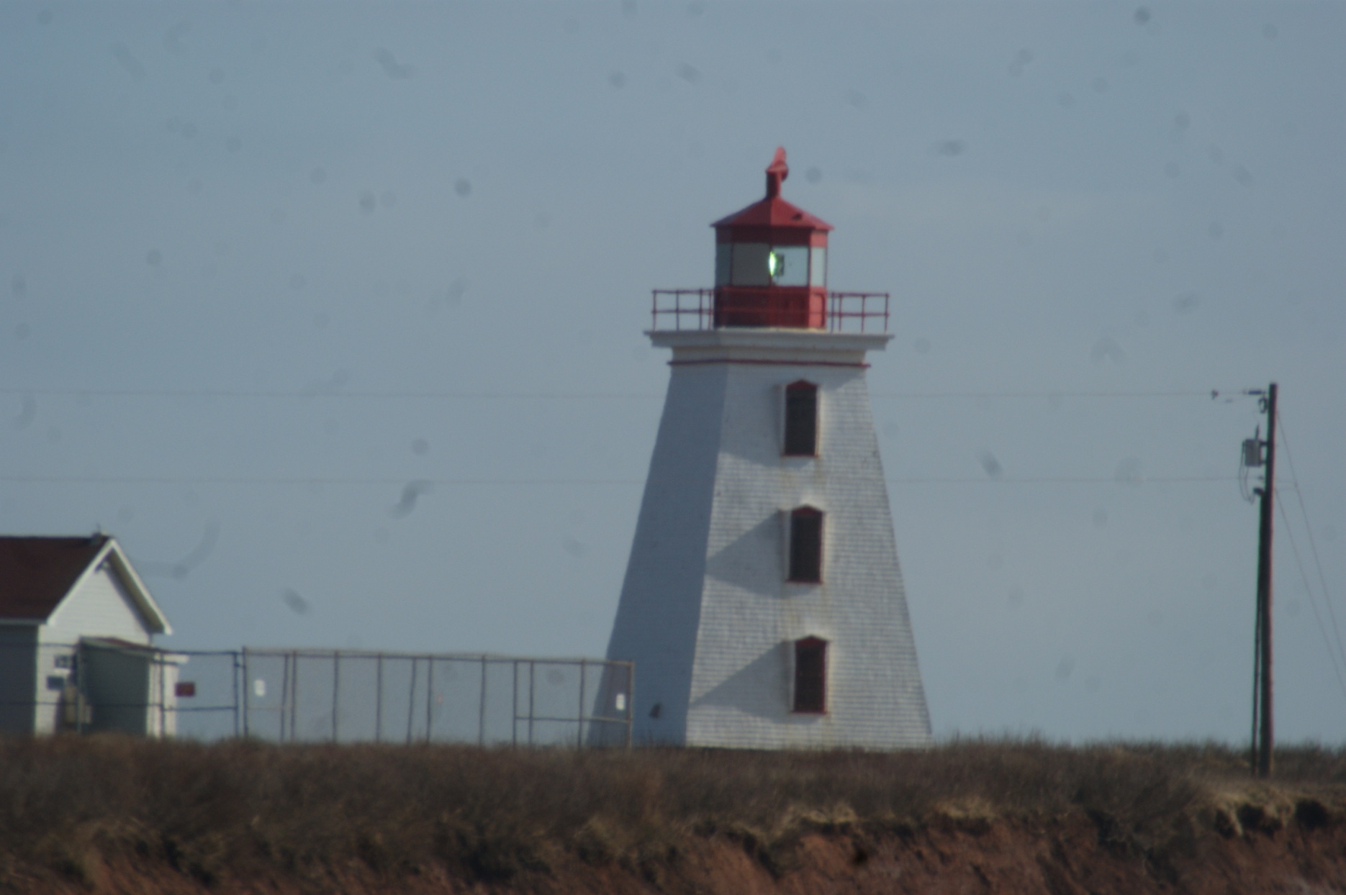
Can-PEI-Cape Egmont

Slide 13
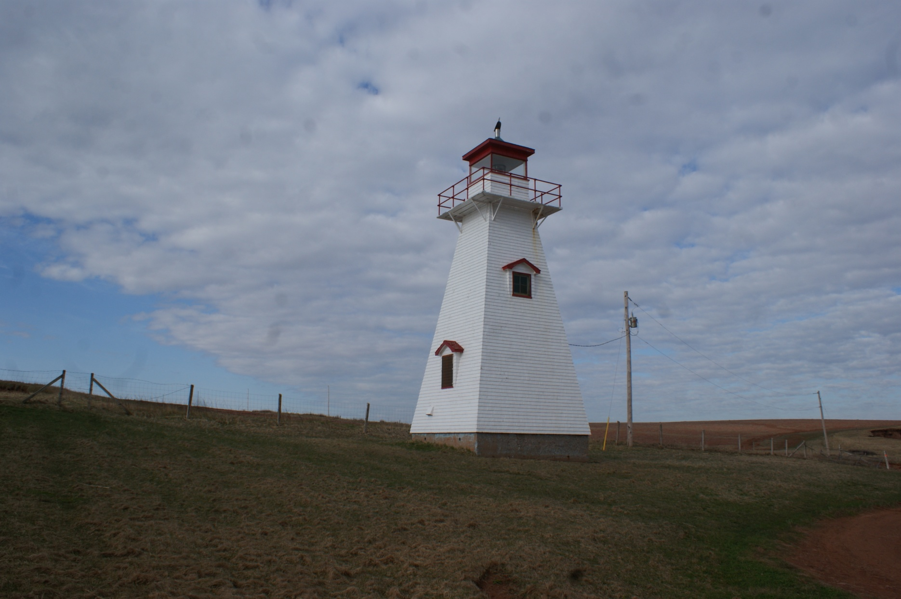
Can-PEI-Cape Tryon

Slide 14
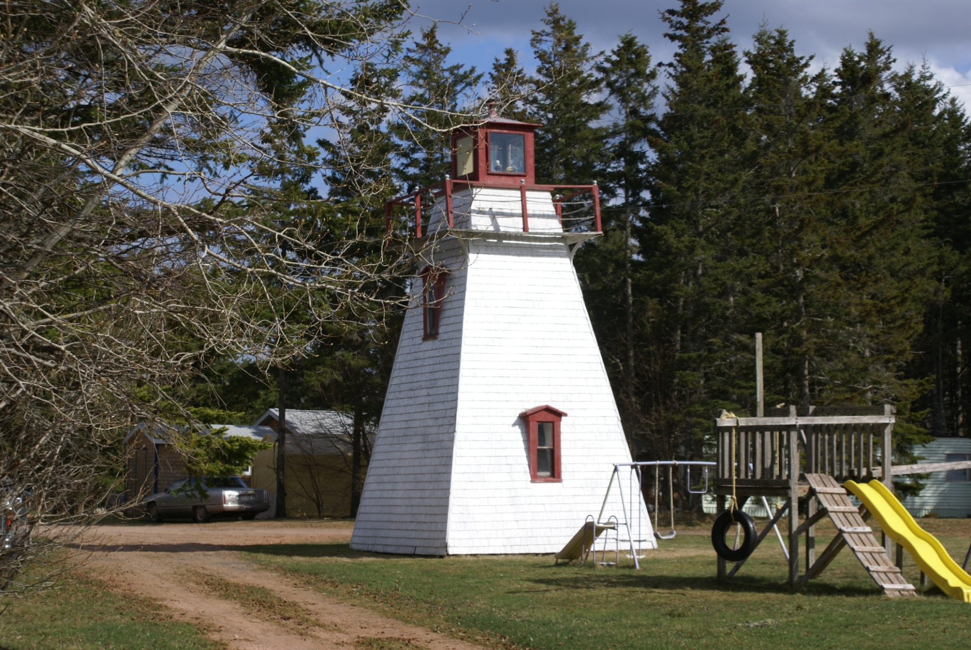
Can-PEI-Cardigan River

Slide 15
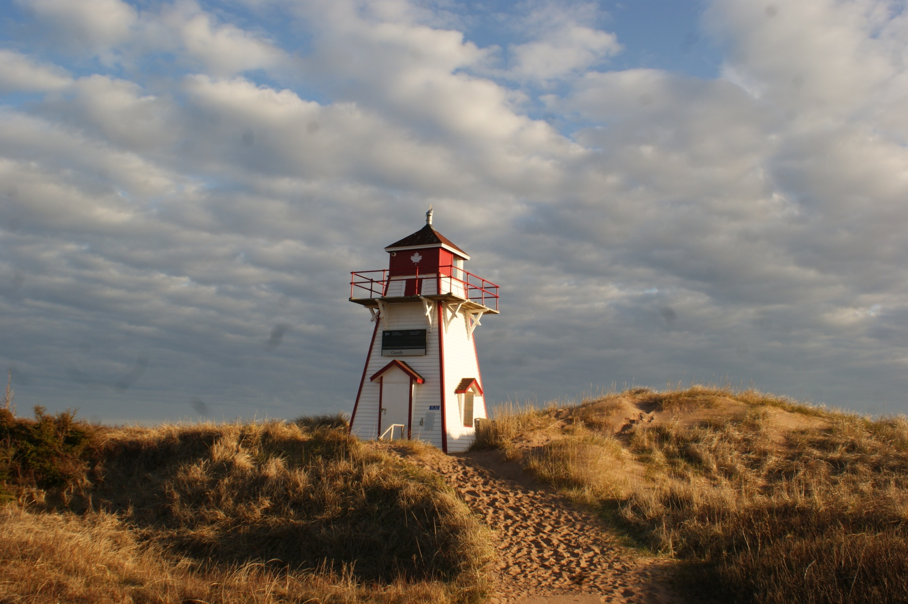
Can-PEI-Covehead Harbour

Slide 16
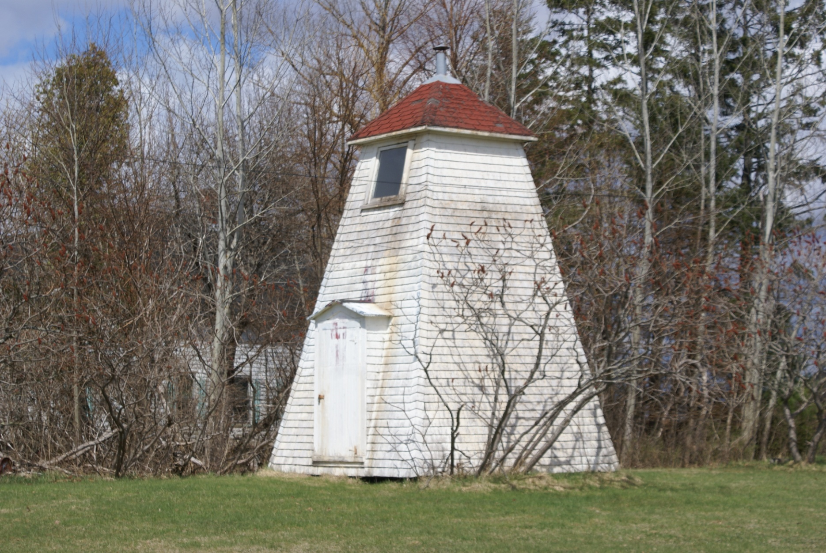
Can-PEI-Douse Point Range Front

Slide 17
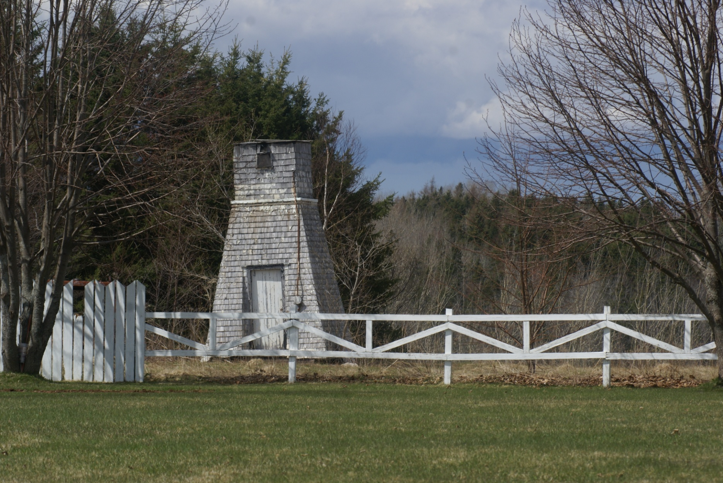
Can-PEI-Douse Point Range Rear

Slide 18
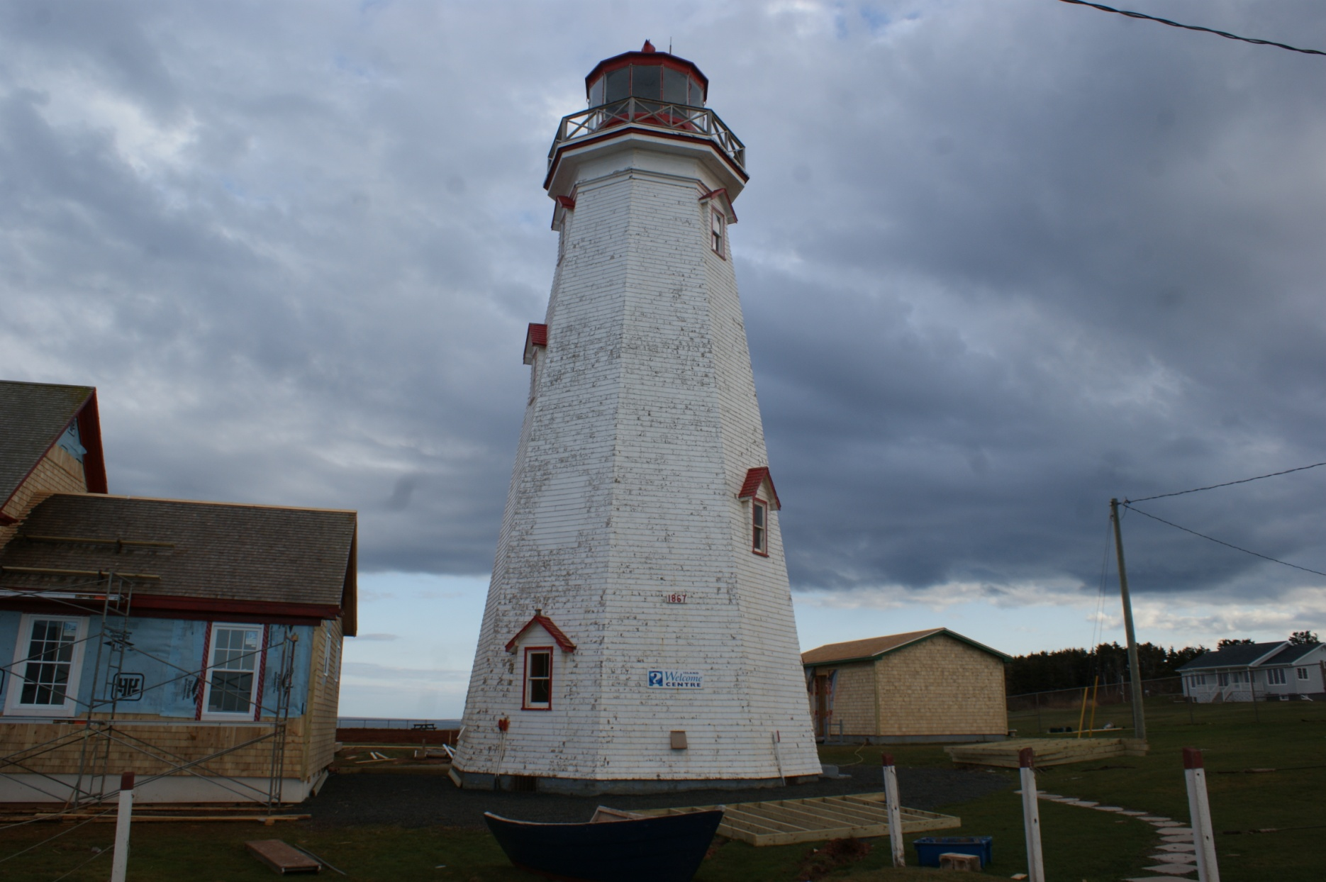
Can-PEI-East Point

Slide 19
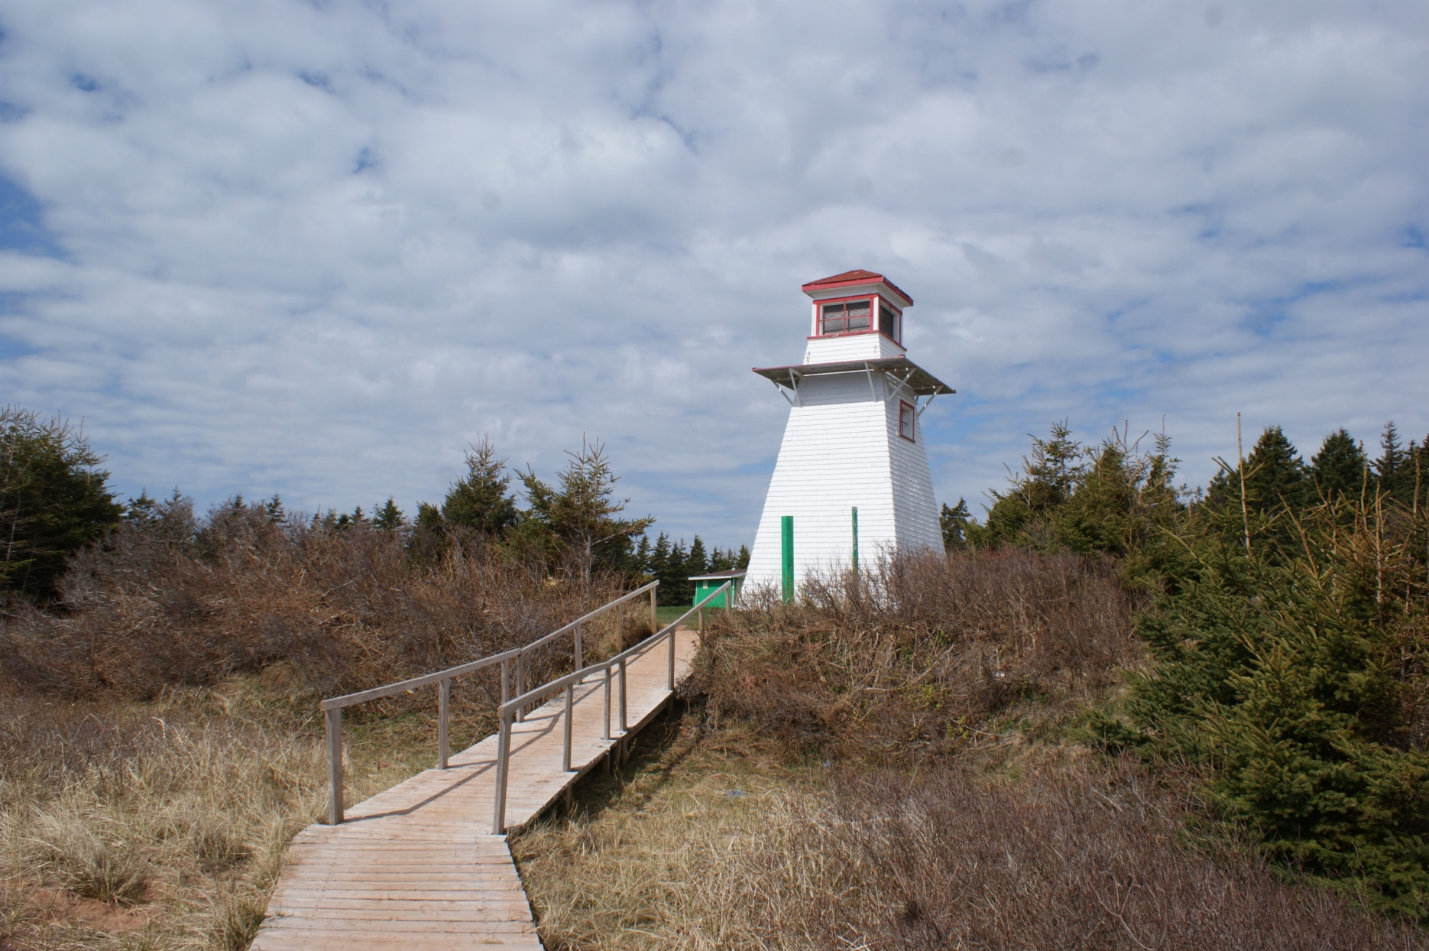
Can-PEI-Fish Island

Slide 20
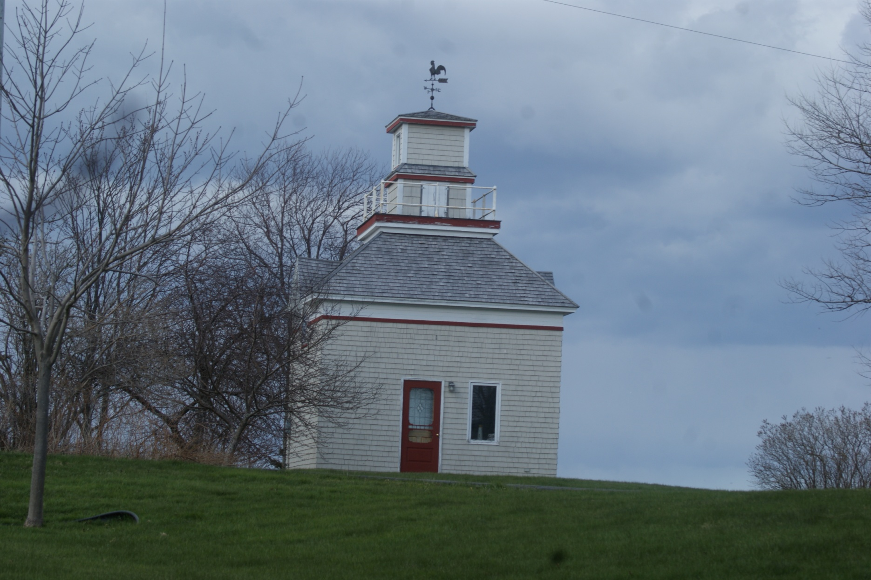
Can-PEI-Georgetown Range Front

Slide 21
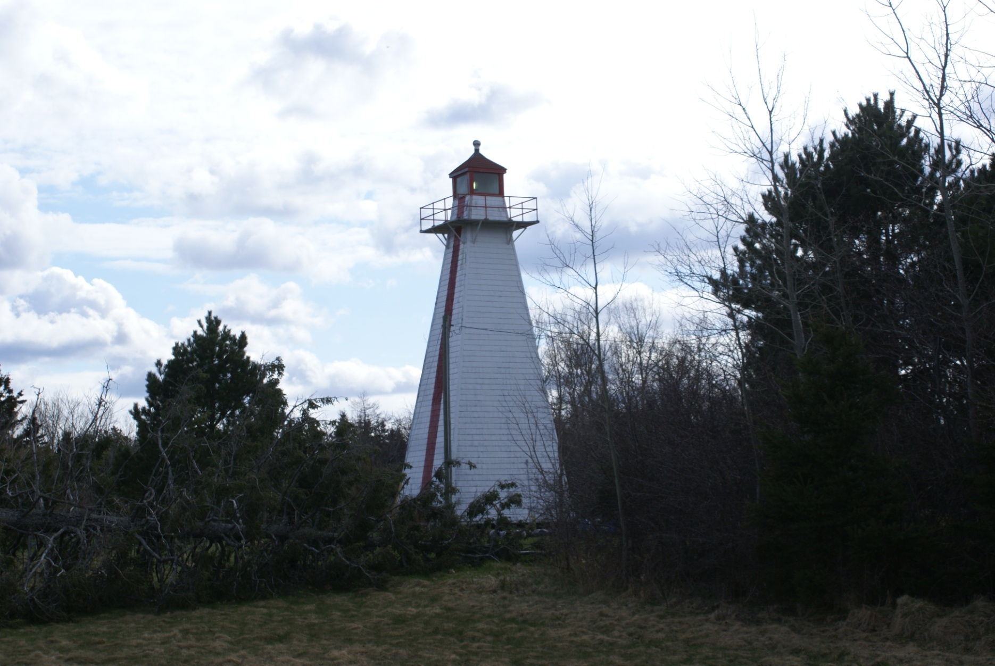
Can-PEI-Georgetown Range Rear

Slide 22
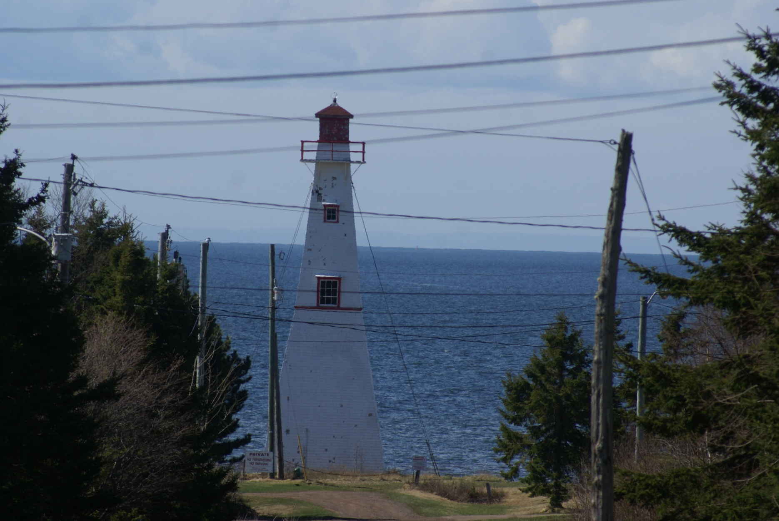
Can-PEI-Harzard Point Range Front

Slide 23
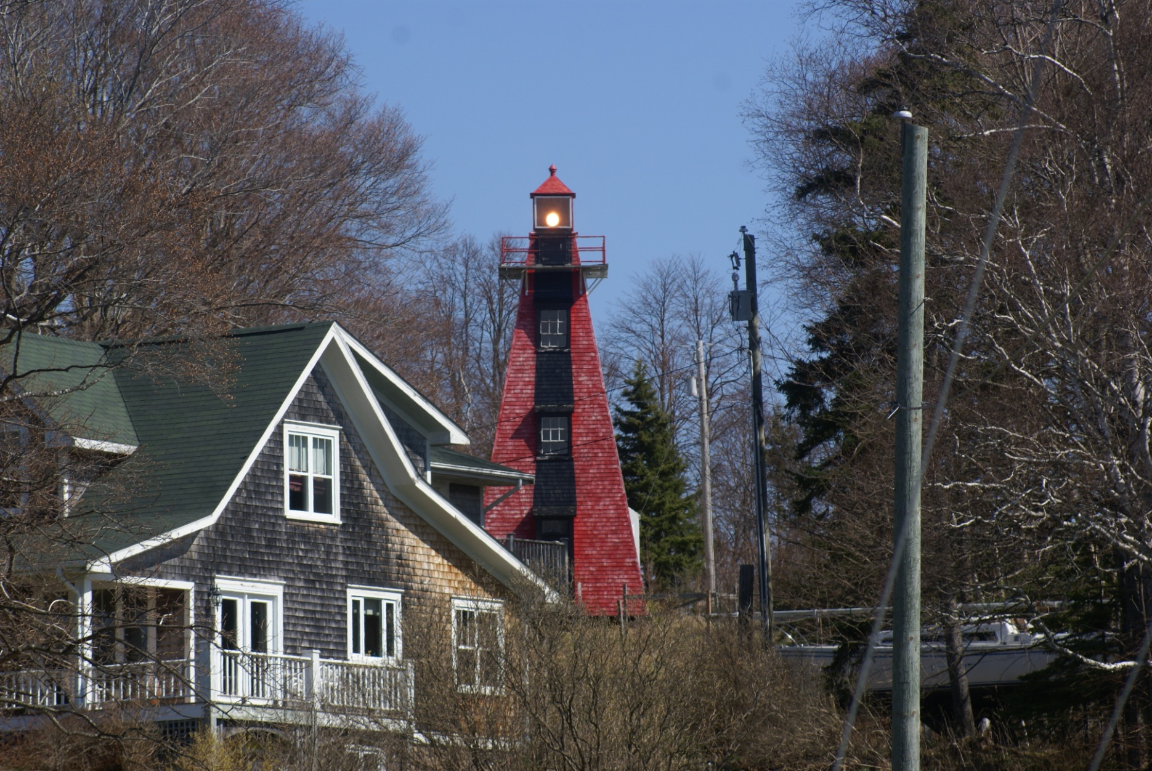
Can-PEI-Hazard Point Range Rear

Slide 24
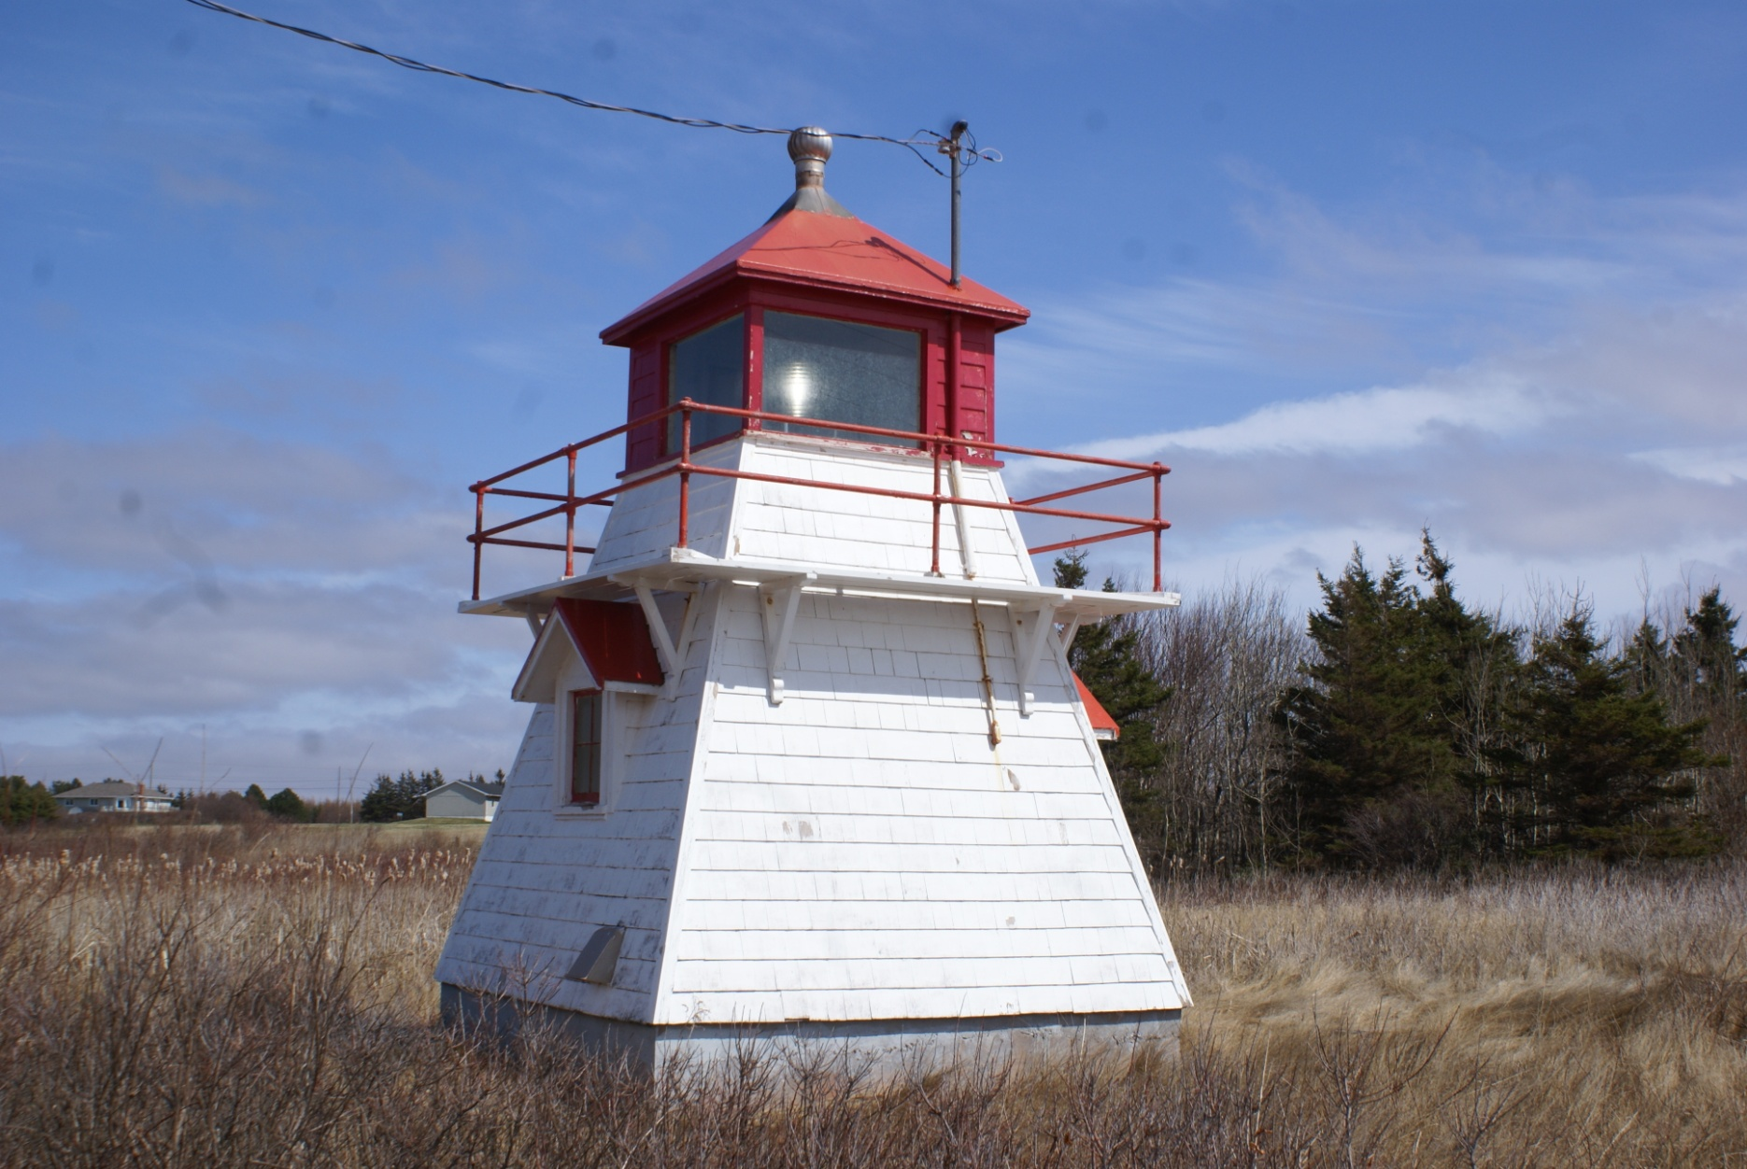
Can-PEI-Howard's Cove

Slide 25
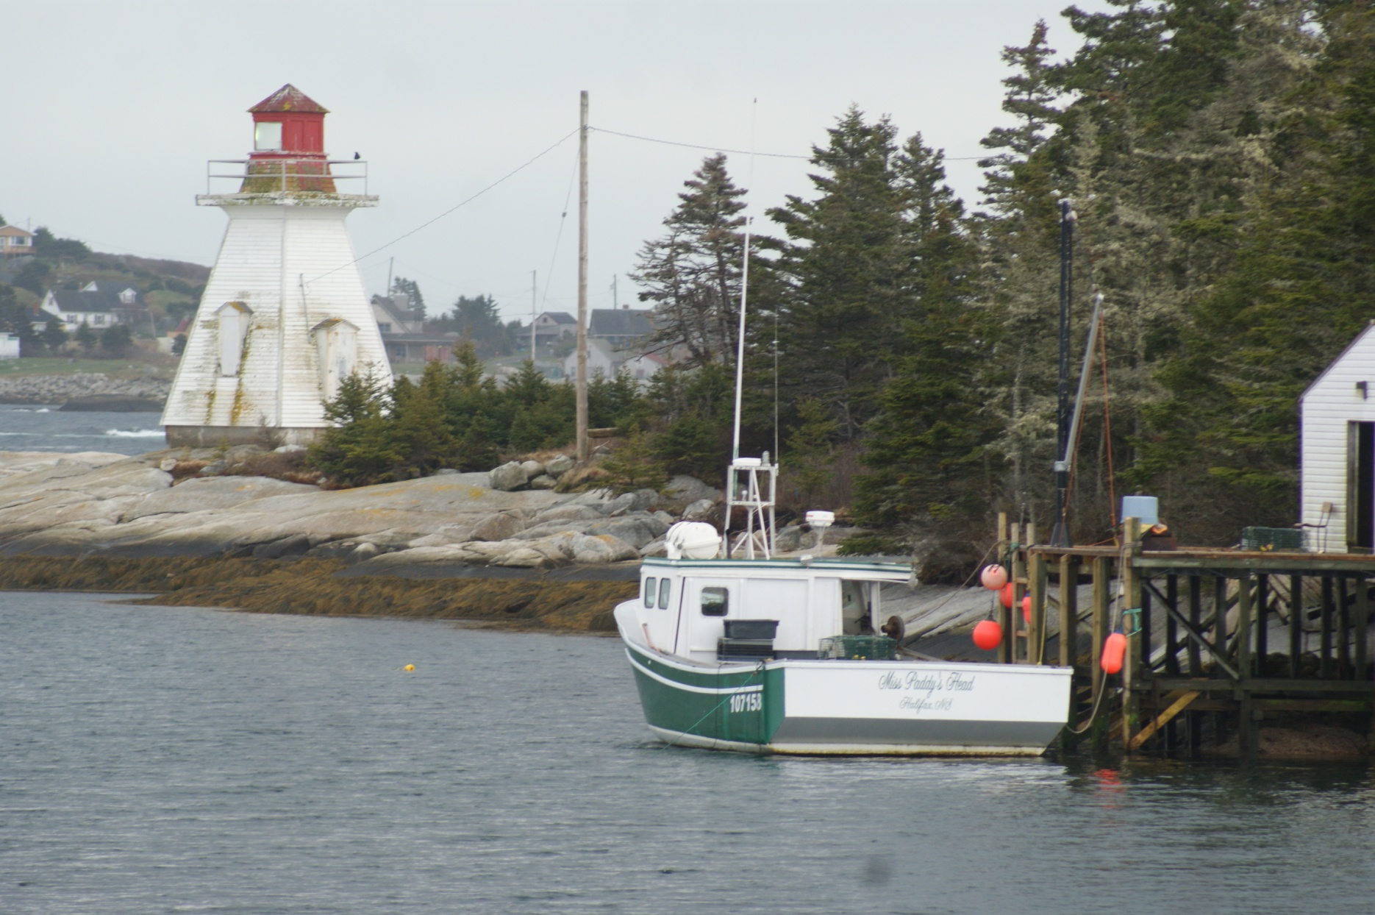
Can-PEI-Indian Head

Slide 26
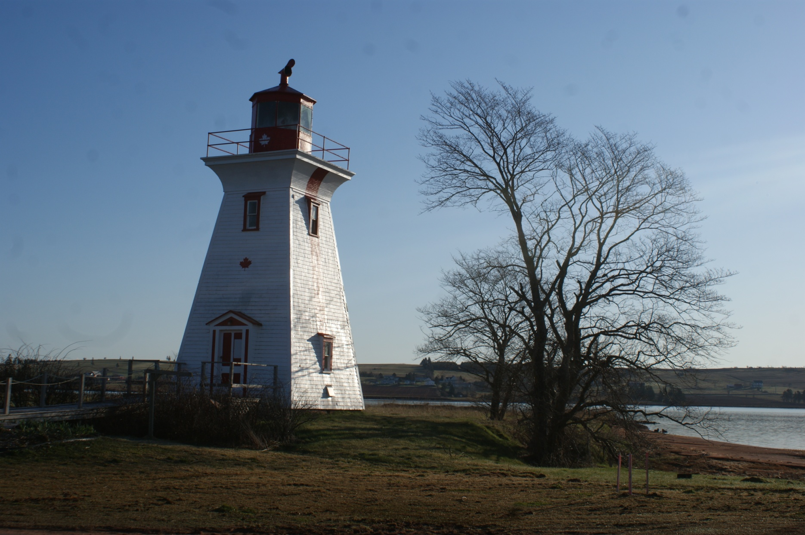
Can-PEI-Leards Range Front

Slide 27
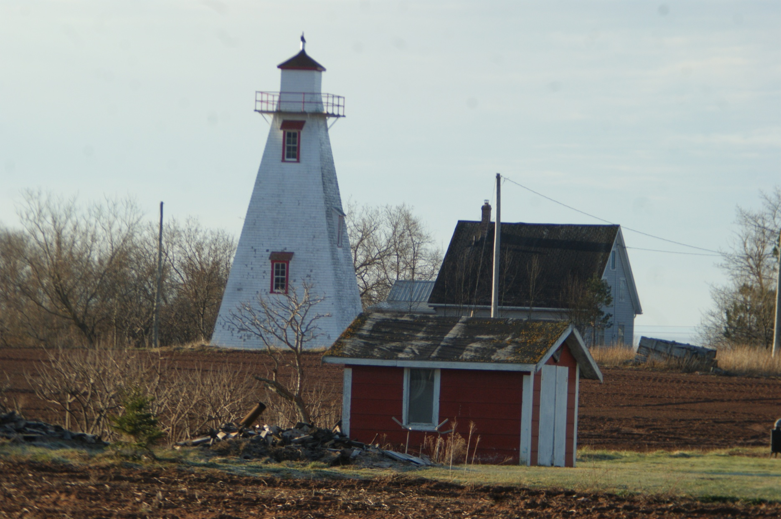
Can-PEI-Leards Range Rear

Slide 28
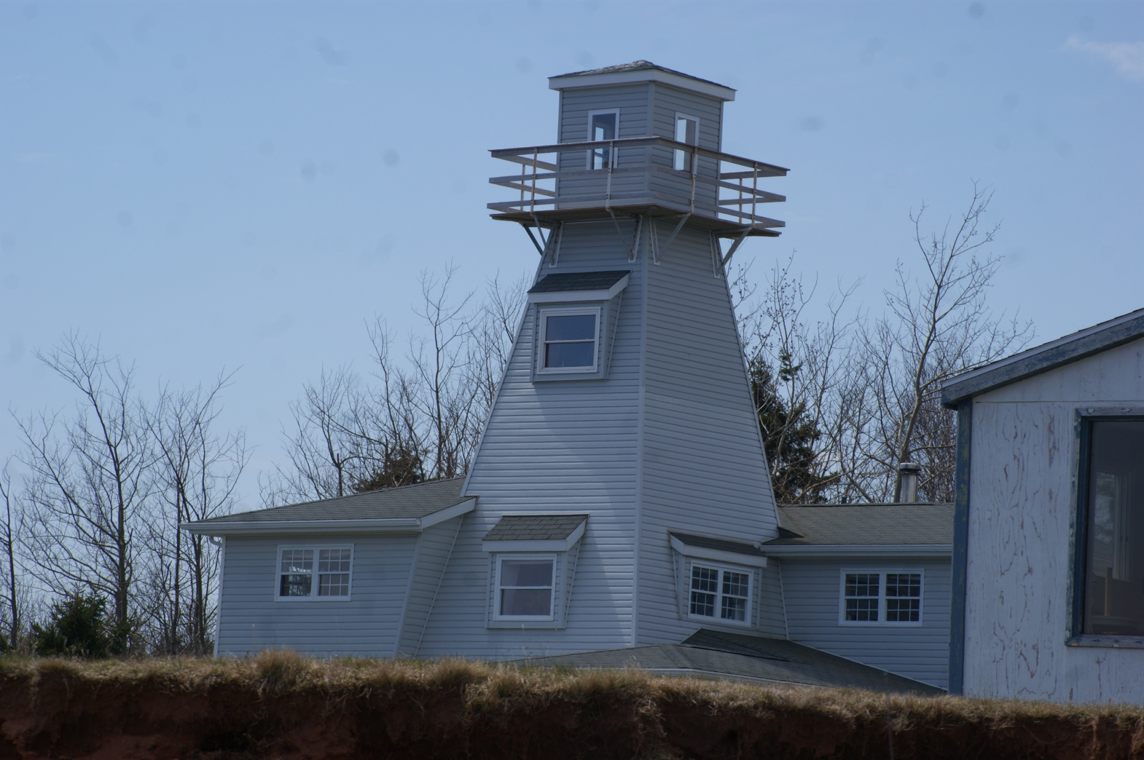
Can-PEI-Little Channel Range Rear

Slide 29
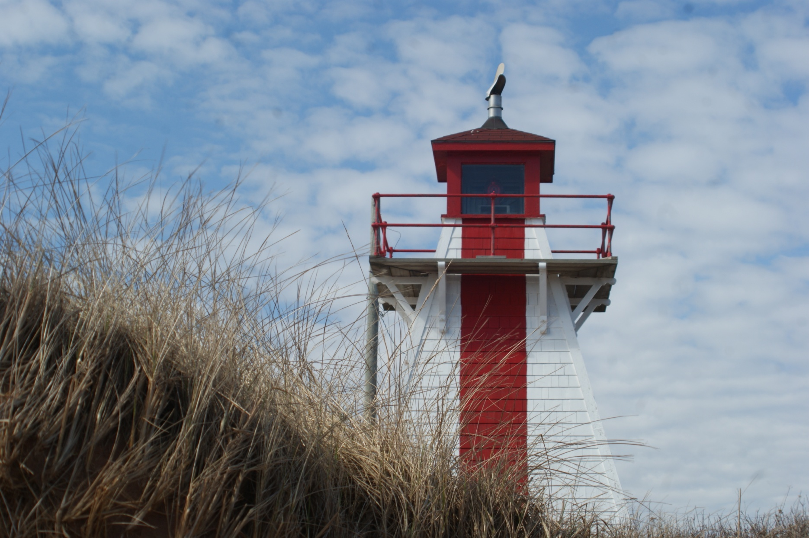
Can-PEI-Malpeque Outer Range Front

Slide 30
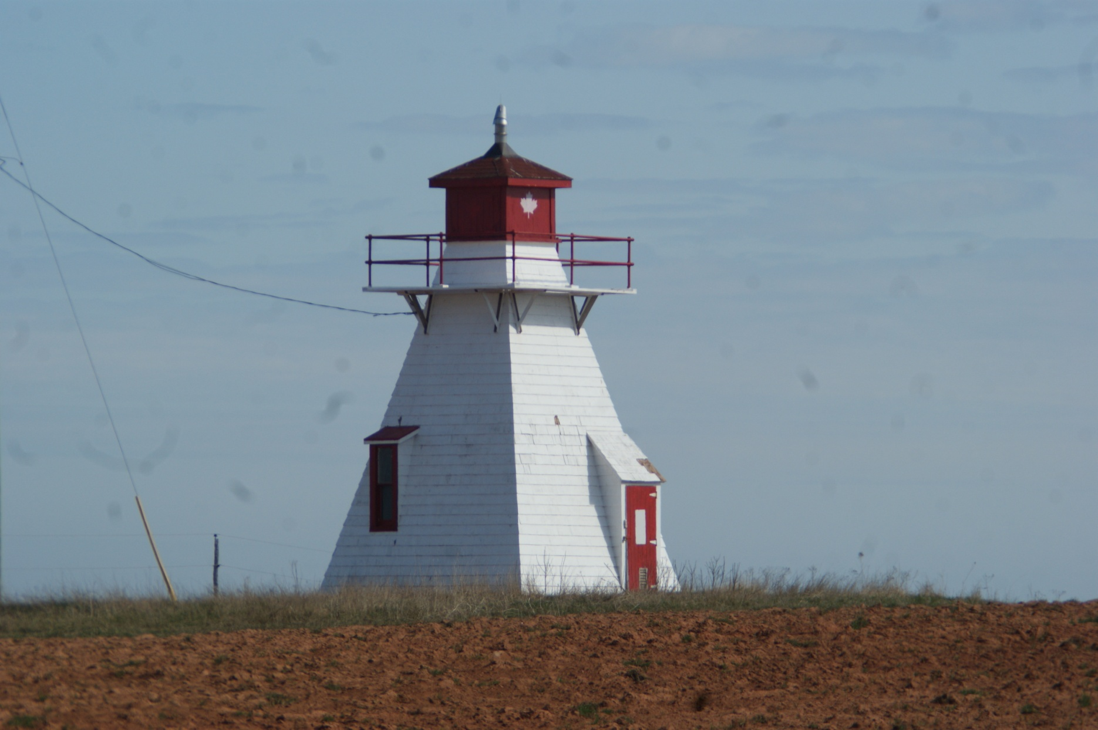
Can-PEI-Malpeque Outer Range Rear

Slide 31
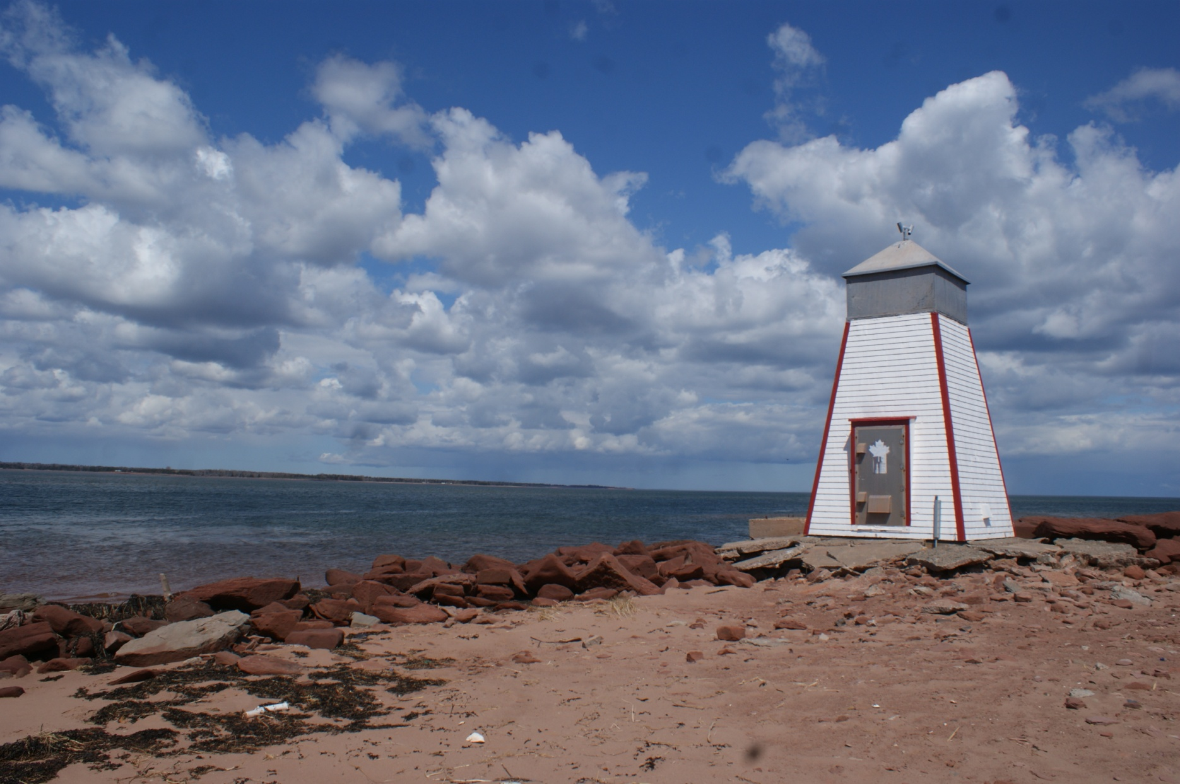
Can-PEI-Murry Harbour Range Front

Slide 32
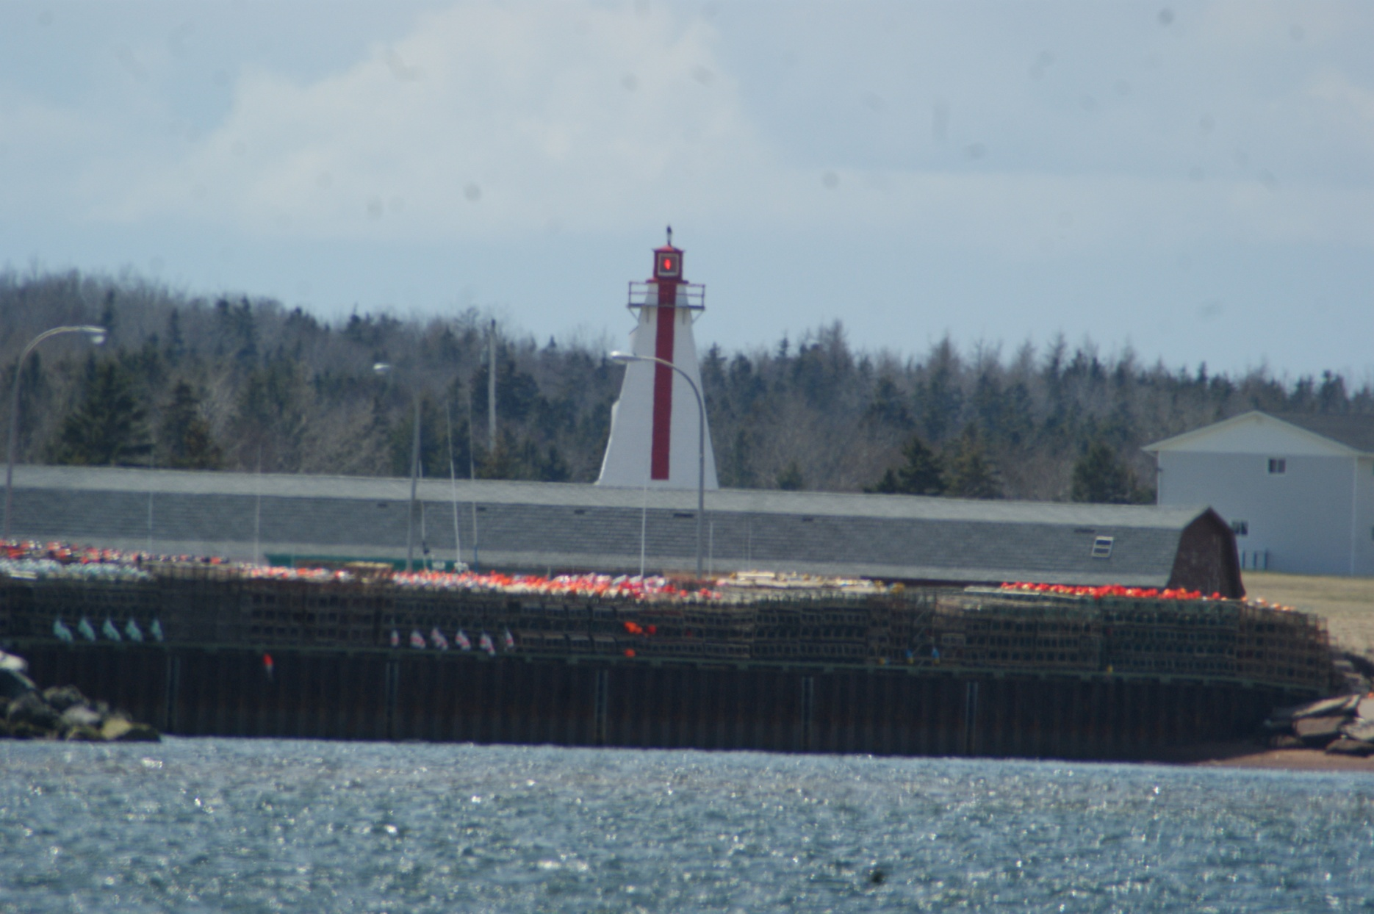
Can-PEI-Murry Harbour Range Rear

Slide 33
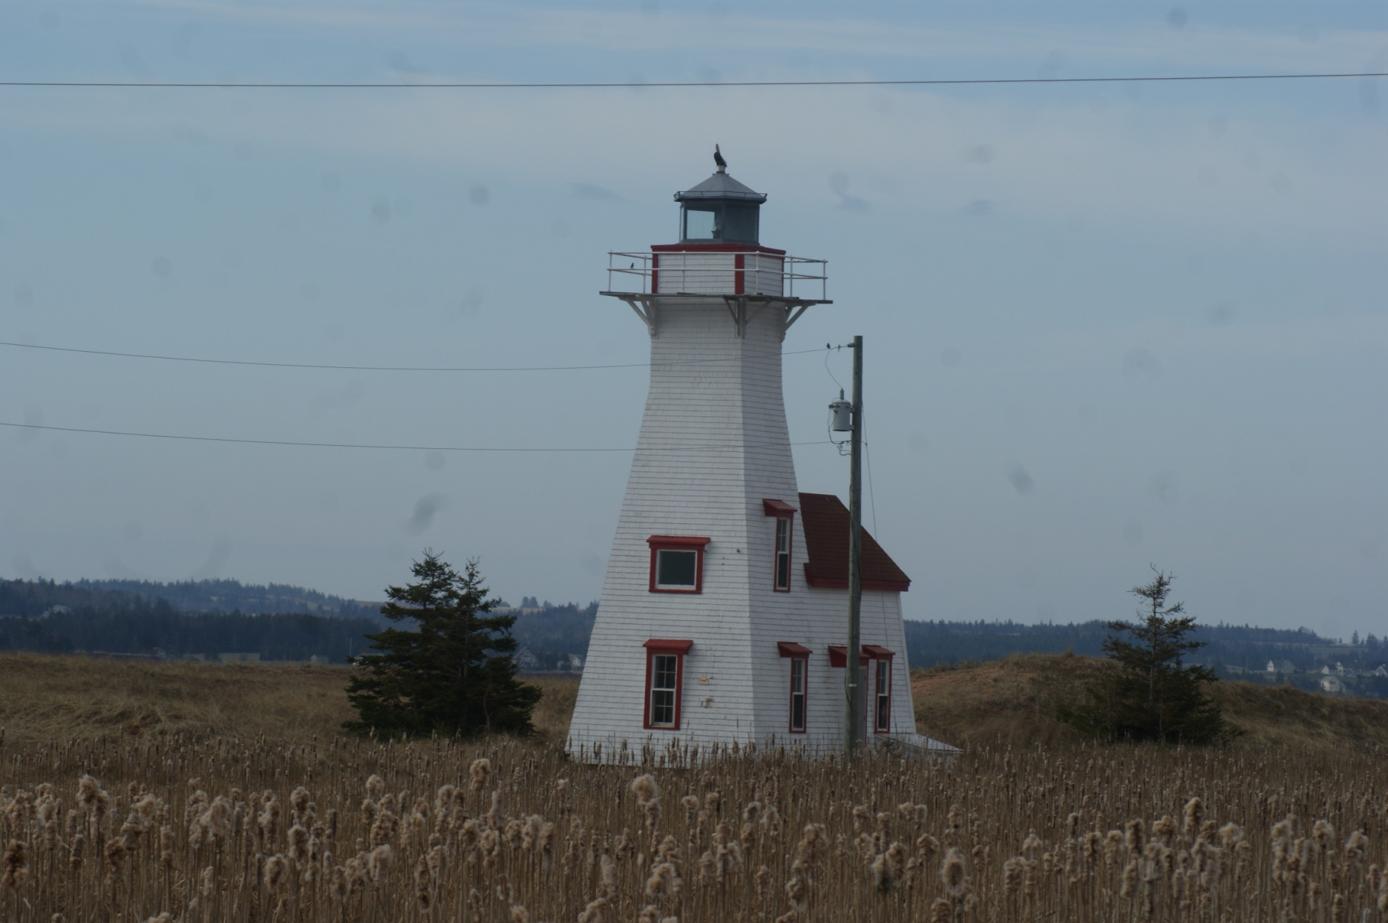
Can-PEI-New London Range Rear

Slide 34
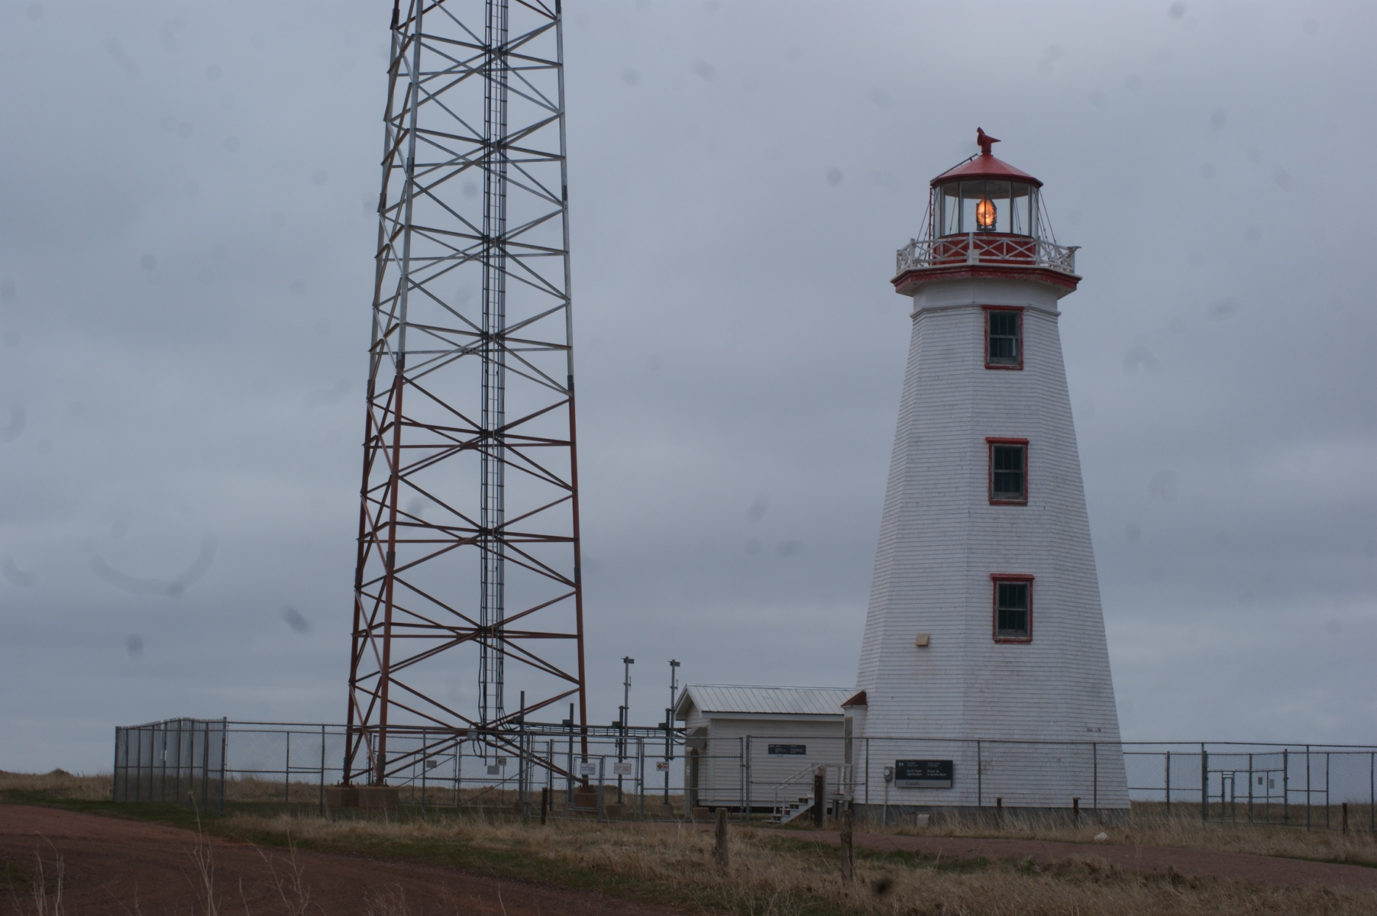
Can-PEI-North Point

Slide 35
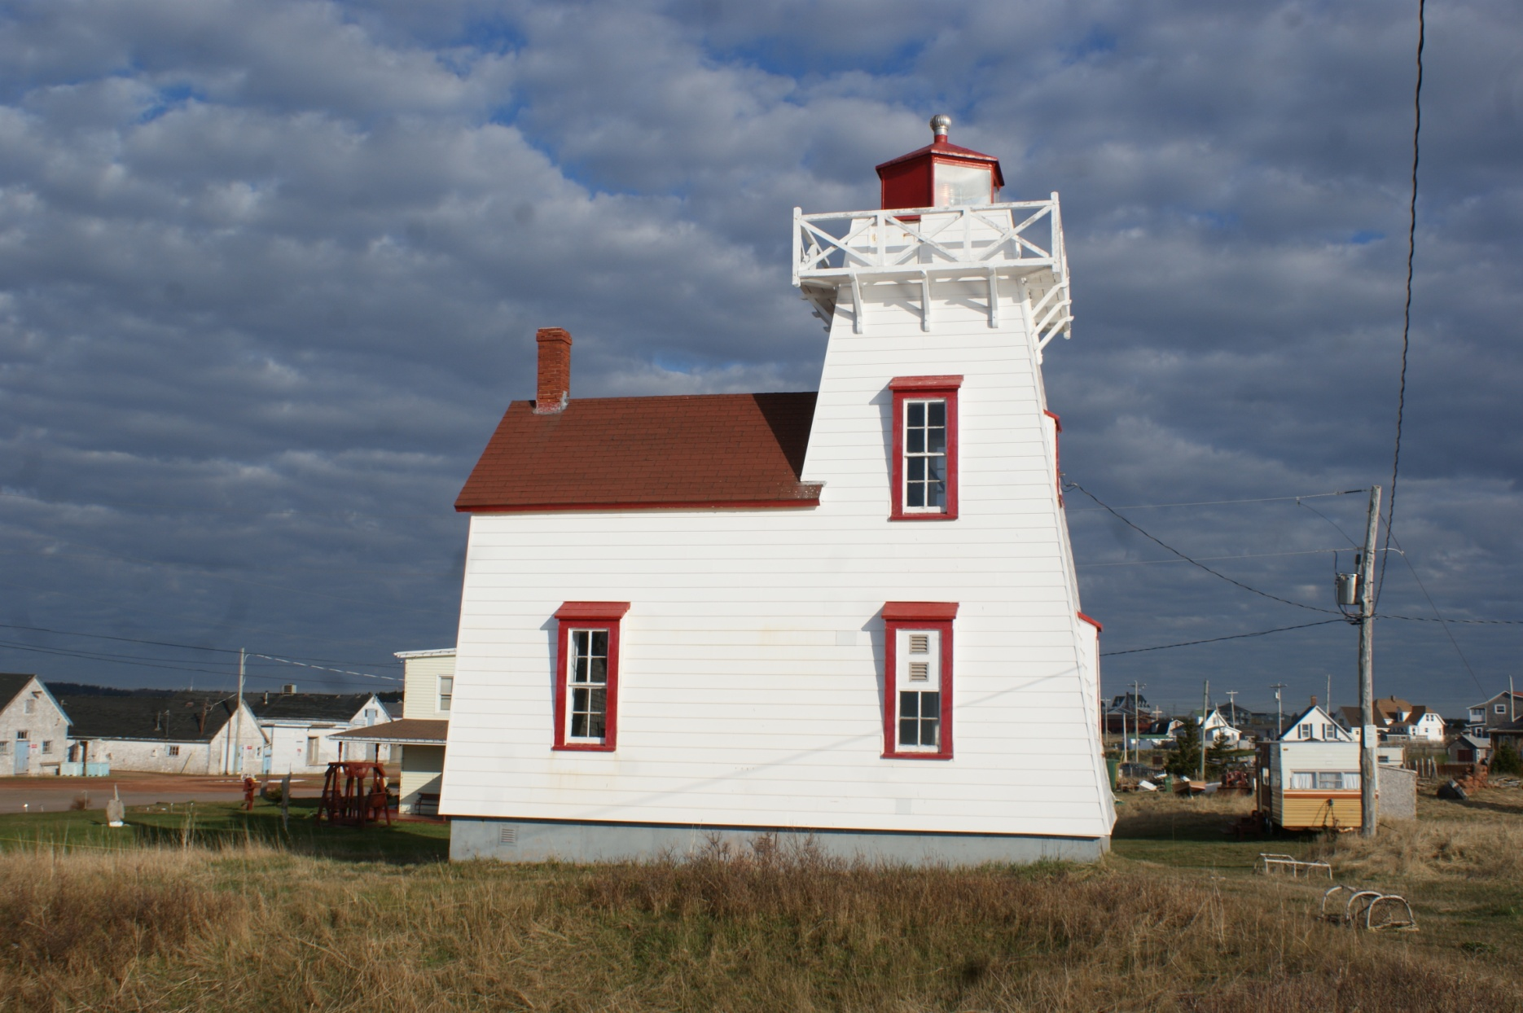
Can-PEI-North Rustico Harbour

Slide 36
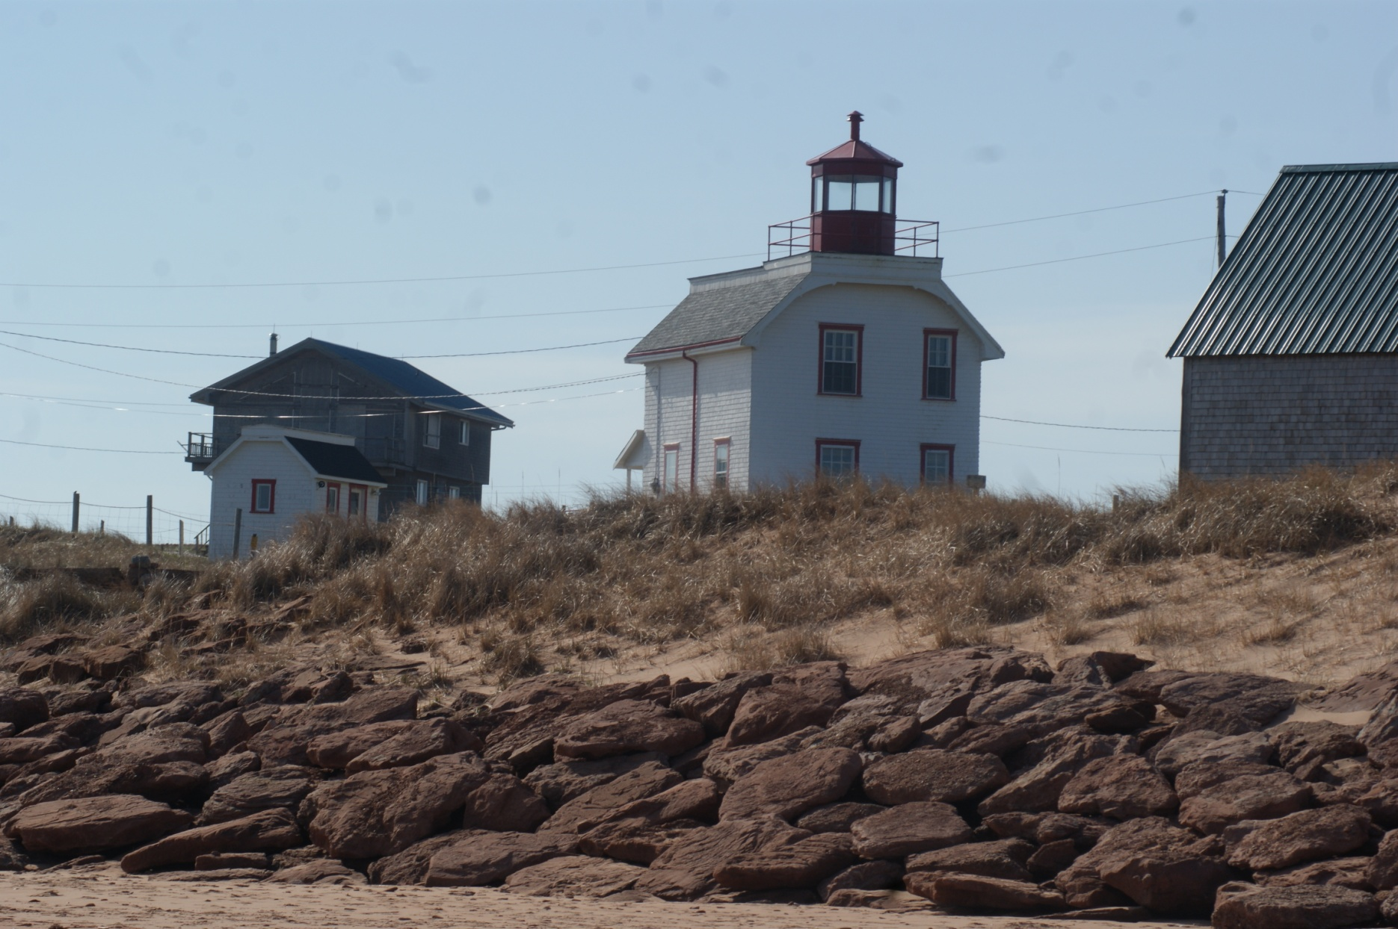
Can-PEI-Old Cape Tryon

Slide 37
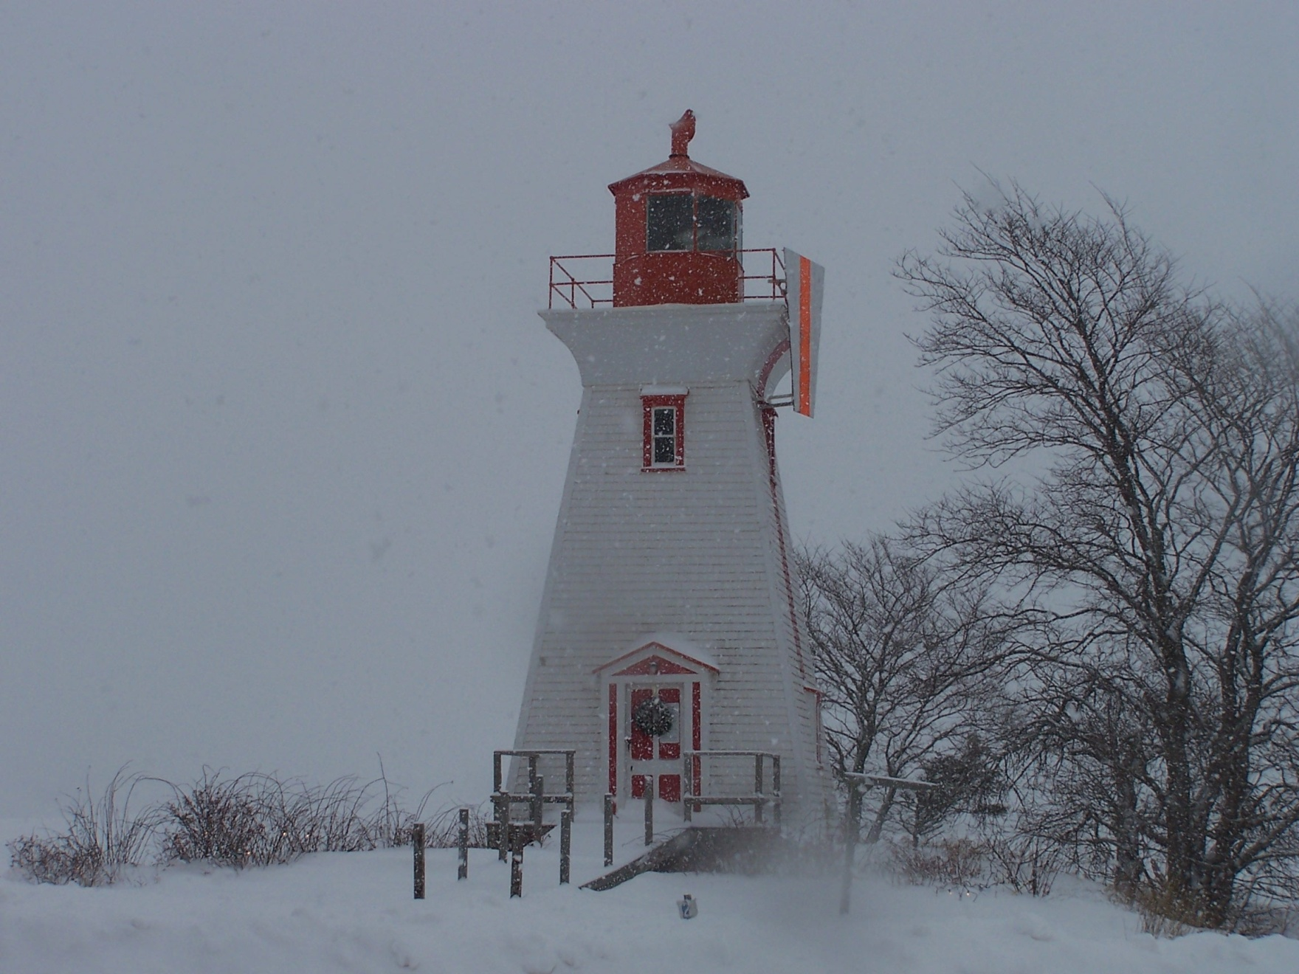
Can-PEI-Palmers Leards Range

Slide 38
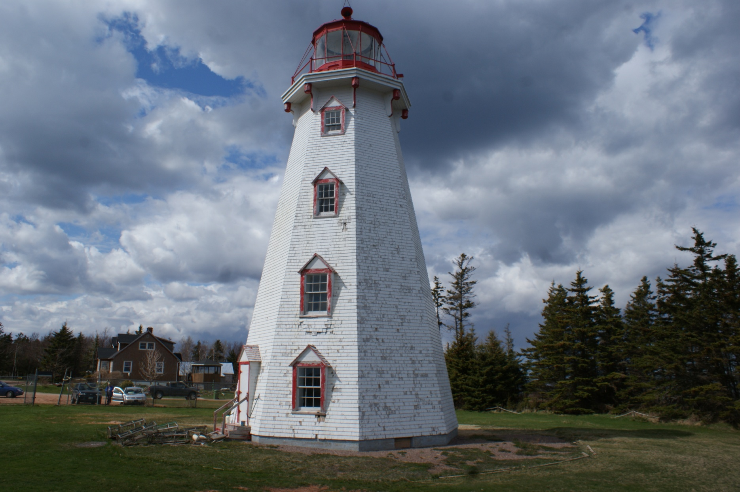
Can-PEI-Panmure Head

Slide 39
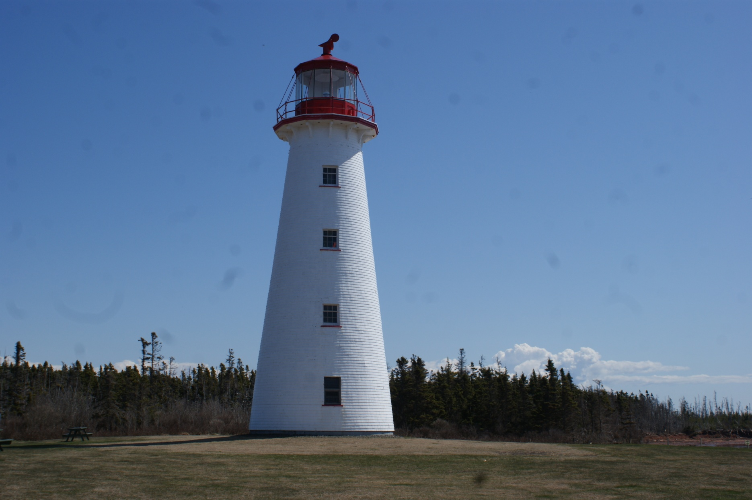
Can-PEI-Point Prim

Slide 40
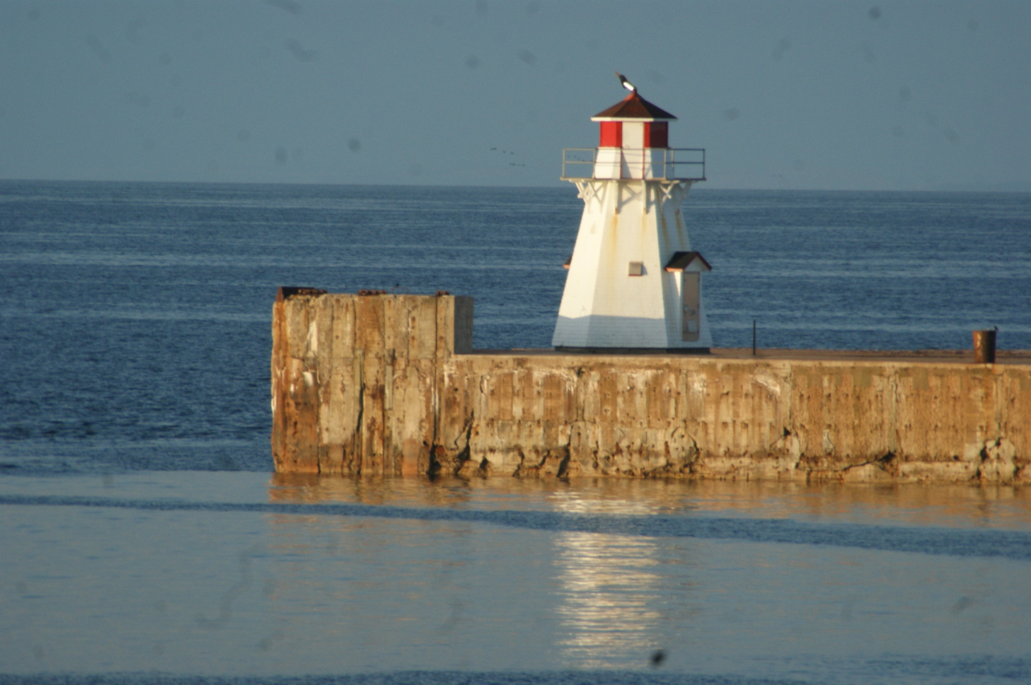
Can-PEI-Port Borden Pier Front

Slide 41
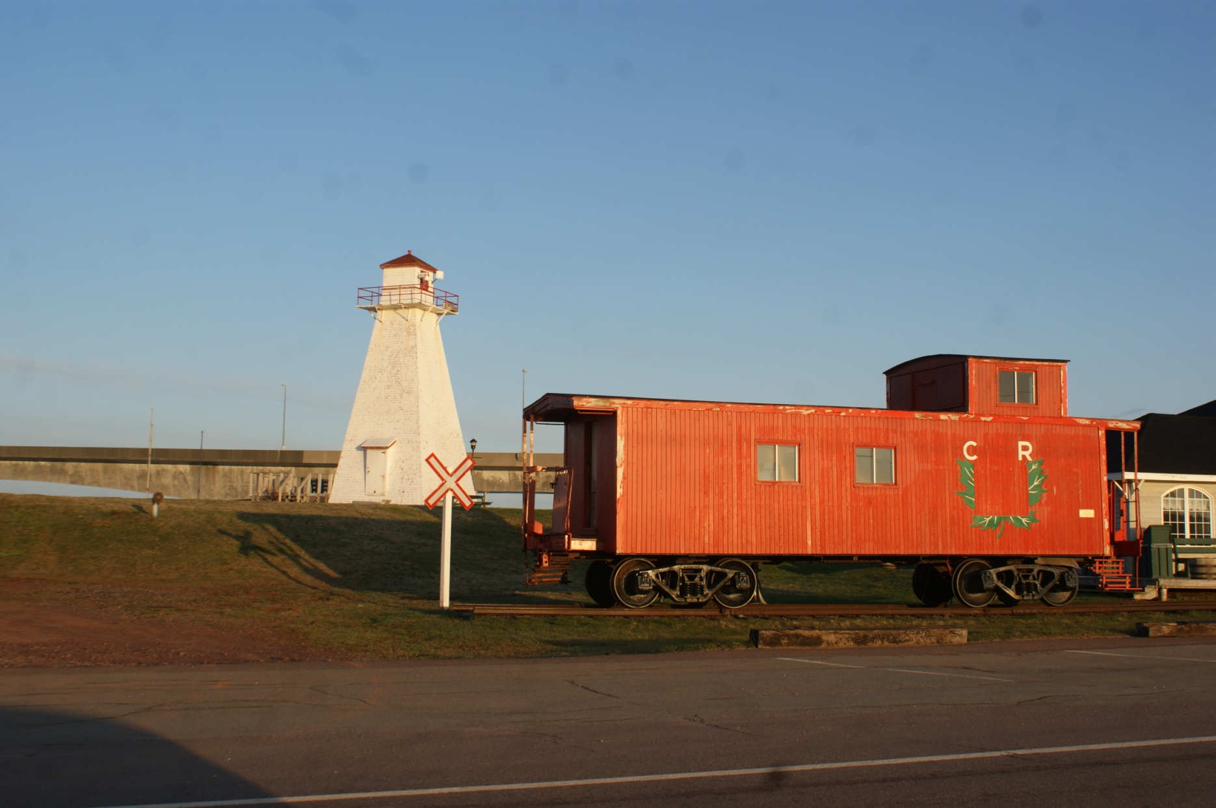
Can-PEI-Port Borden Pier

Slide 42
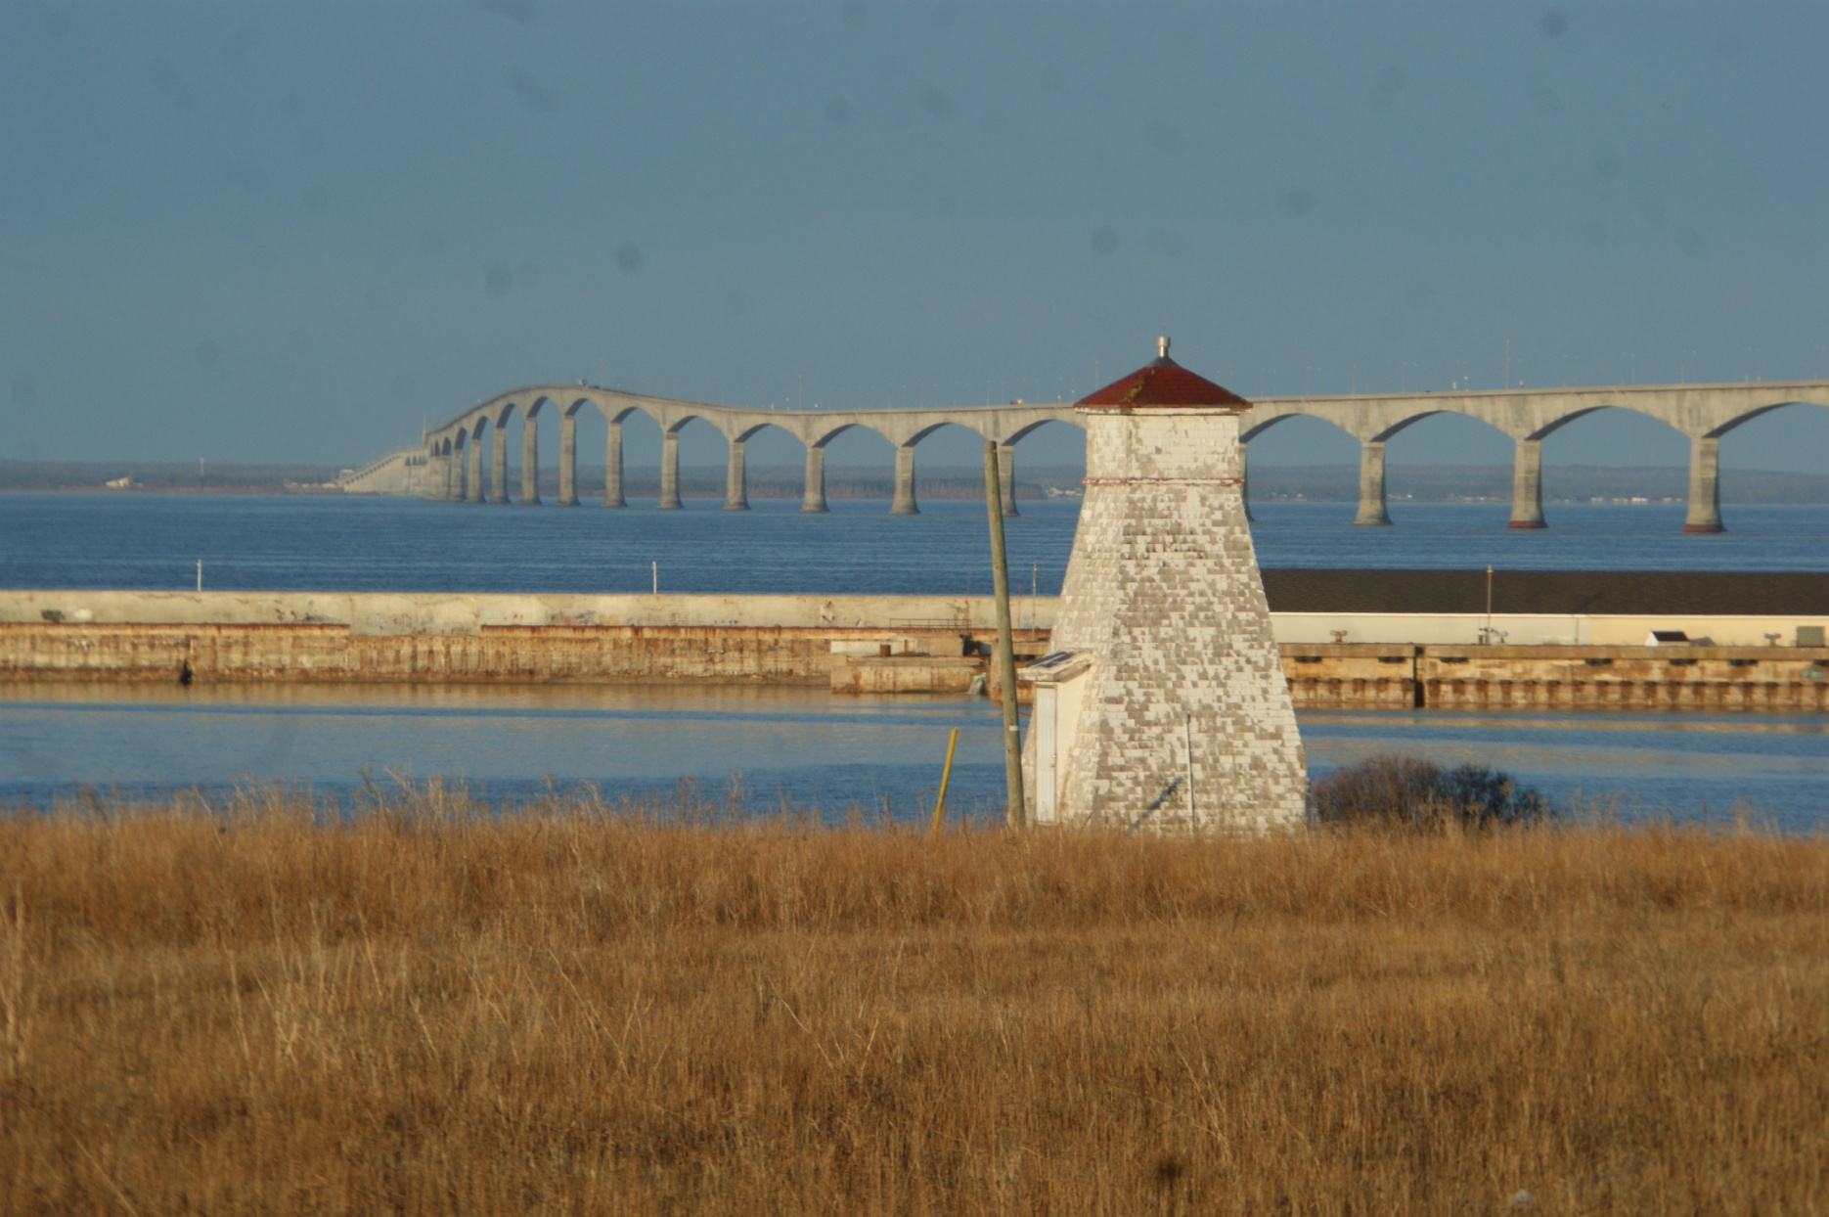
Can-PEI-Port Borden Range Rear

Slide 43
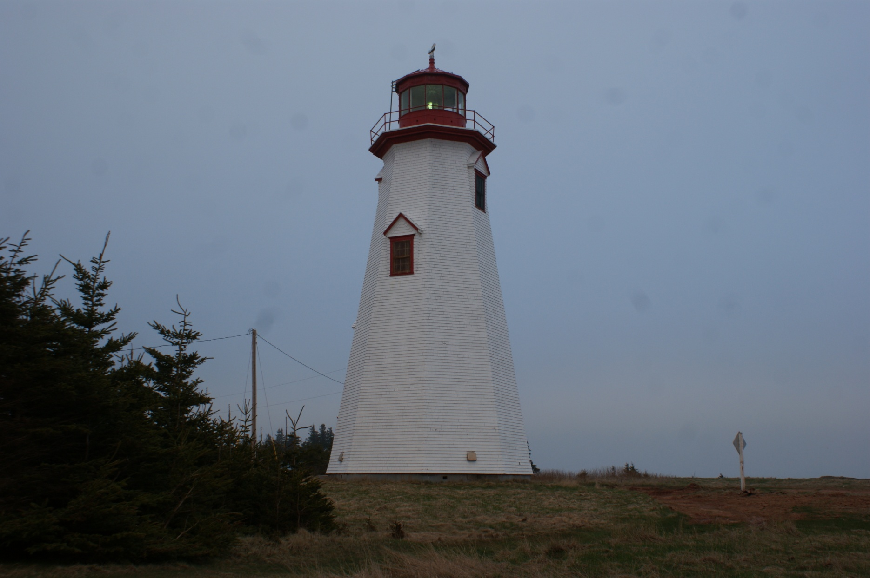
Can-PEI-SeaCow

Slide 44
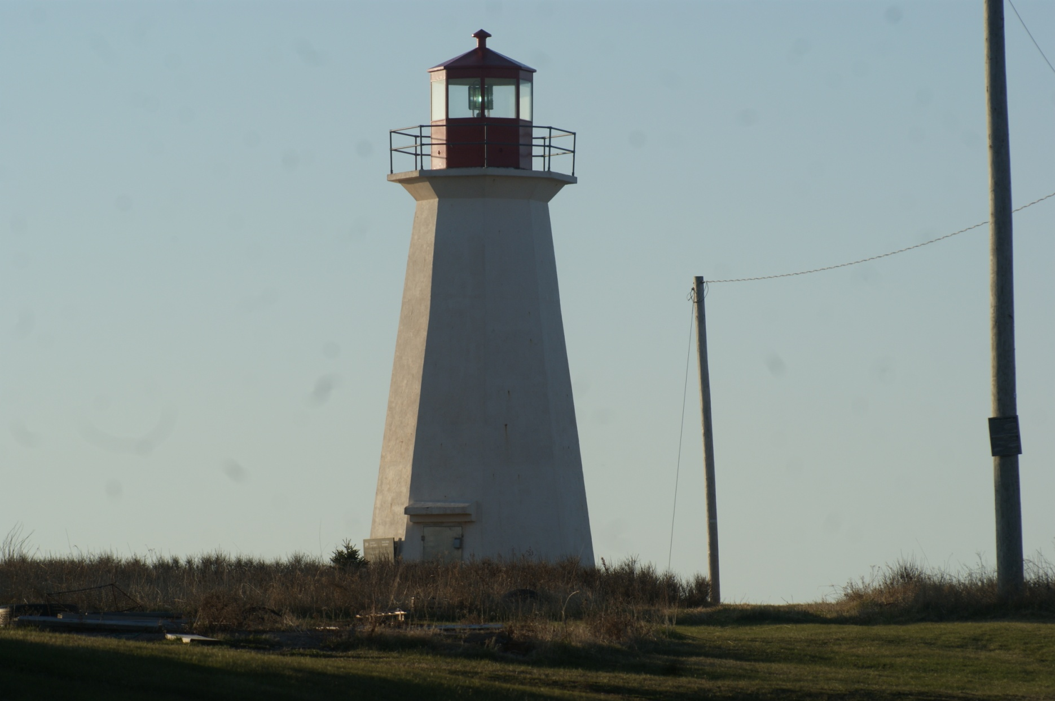
Can-PEI-Shipwreck Point

Slide 45
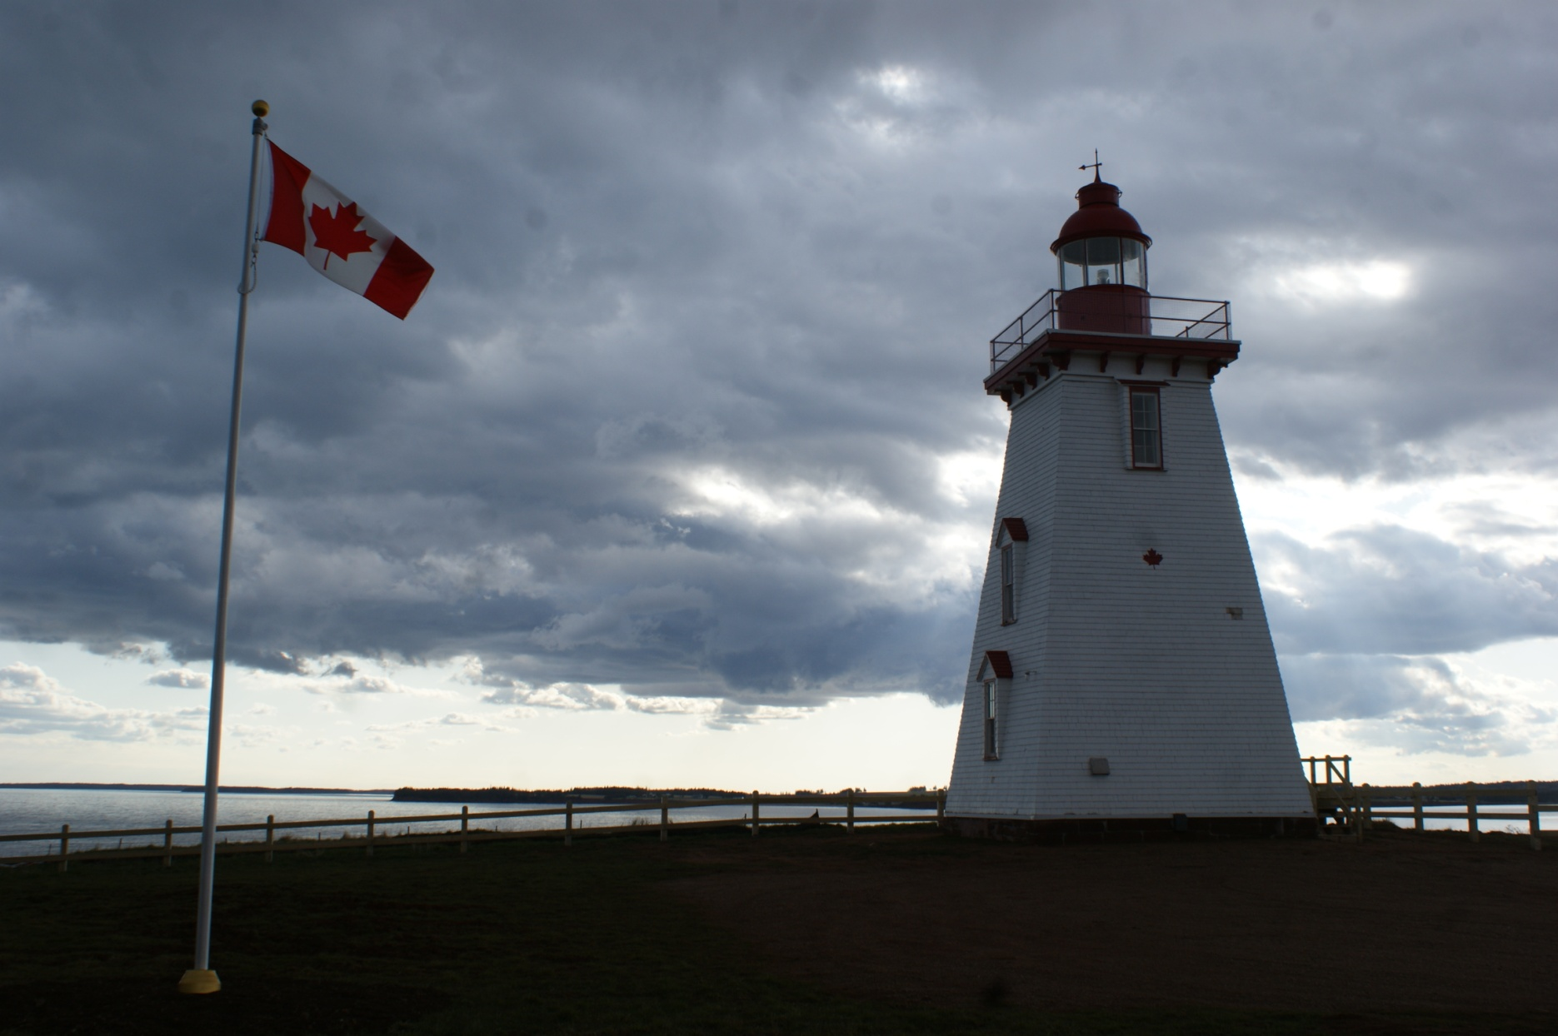
Can-PEI-Souris East

Slide 46
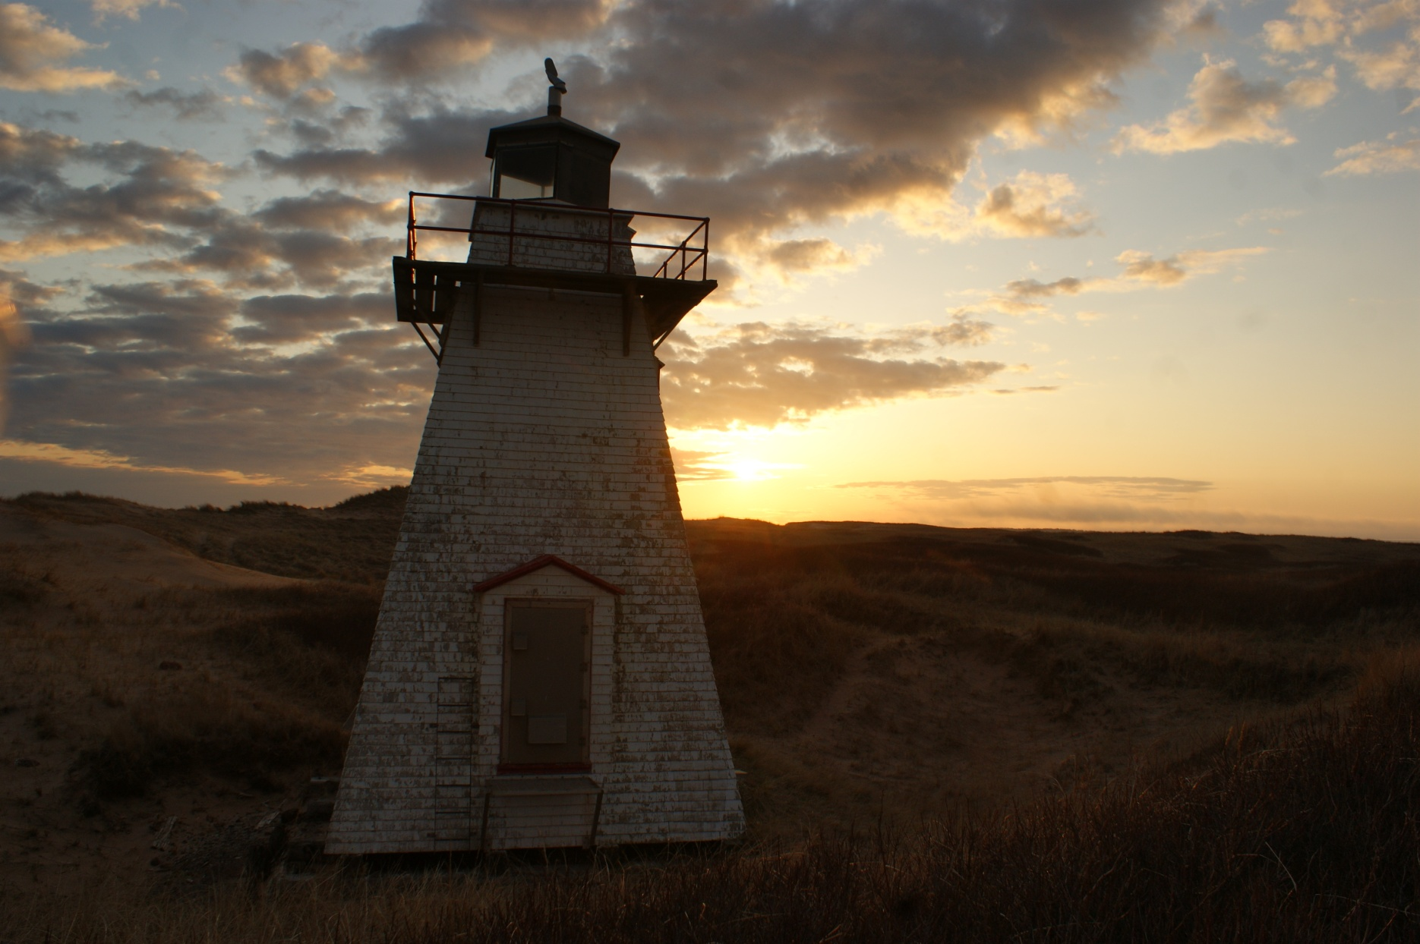
Can-PEI-St Peter's Harbour

Slide 47
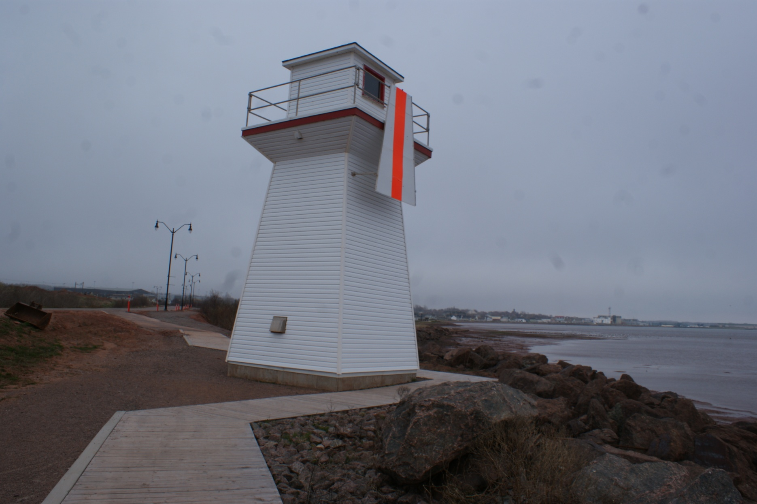
Can-PEI-Summerside Outer Range Front

Slide 48
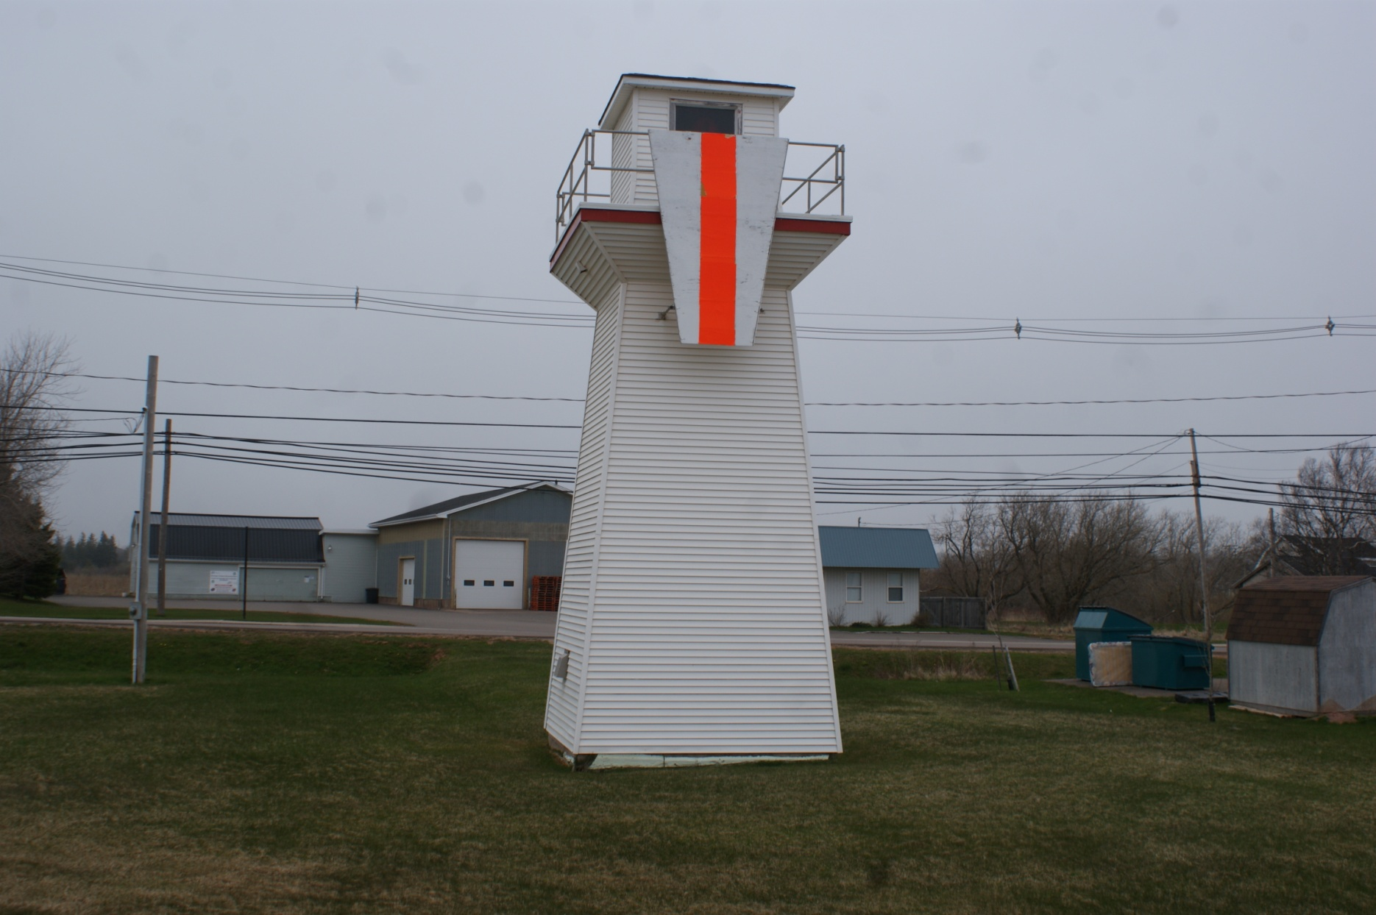
Can-PEI-Summerside Outer Range Rear

Slide 49
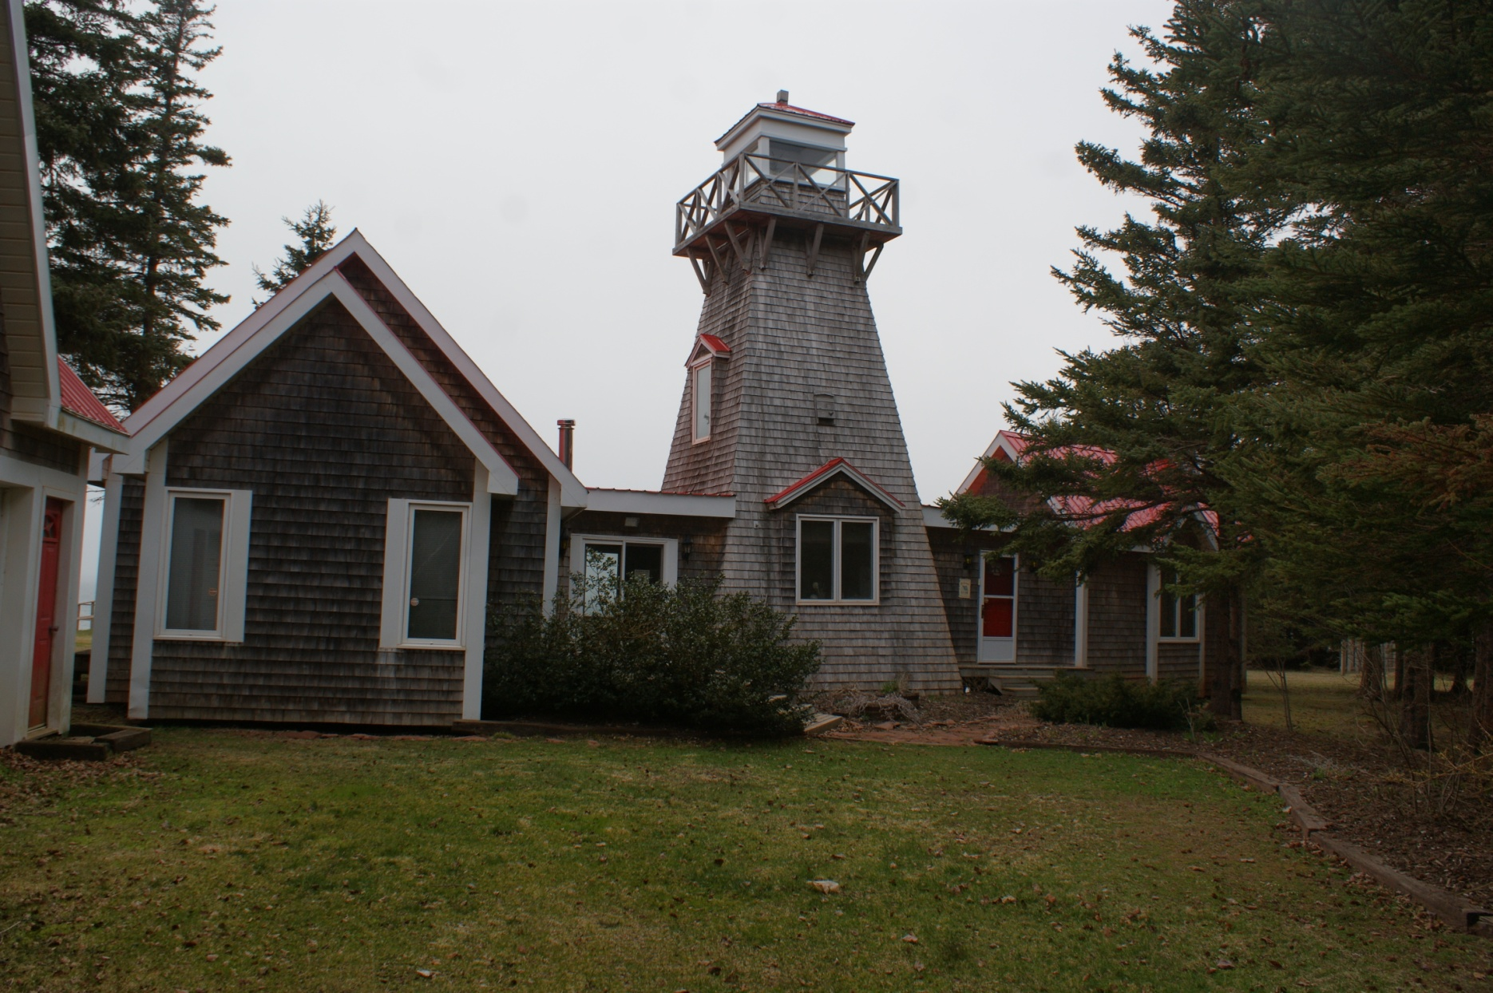
Can-PEI-Summerside Range Front

Slide 50
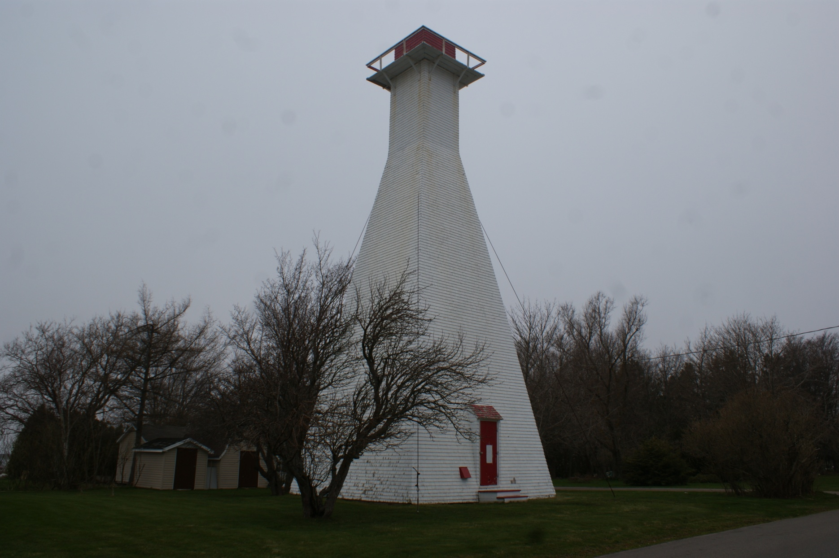
Can-PEI-Summerside Range Rear

Slide 51
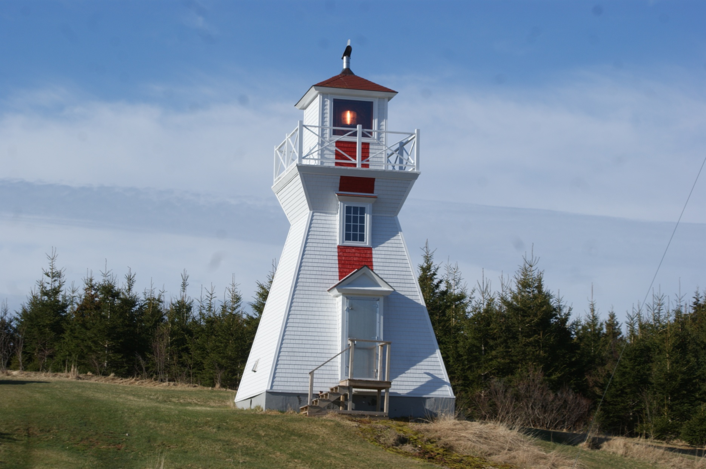
Can-PEI-Warren Cove Range Rear

Slide 52

Can-PEI-West Point

Slide 53

Can-PEI-Woods Island Range Front

Slide 54

Can-PEI-Woods Island Range Rear

Slide 55

Can-PEI-Woods Island

Slide 56

Can-PEI-Wrights Range Rear

Slide 57

Can-Warren Cove Range Front

Slide 58

Can-PEI-Annandale Range Lights

Slide 59

Can-PEI-Murry’ s Harbour Range Front

